Slide 1
Charts | March 19
BRINGING CHART-MAKING OUT OF THE BACK-END
Presented by: Daniel Cothran | John Snow, Inc. (JSI)

Slide 2

Daniel Cothran, MPH
Technical Advisor and Drupal Portfolio Manager at John Snow, Inc. (JSI)
drupal.org/u/andileco
Won’t stop bringing up the Charts module.
Notes:
I’m Daniel Cothran or andileco on Drupal.org. I work at JSI. We’re a public health company named after the “father of epidemiology,” John Snow. Before this year, I frequently had to explain what public health and epidemiology are - sadly that’s no longer the case. As you might have seen, there are a lot of challenging issues in public health, and we have a lot of projects working to address many of these issues. Some of those projects had Drupal websites and wanted to visualize their data. So I started working on a Drupal 8 version of the Charts module, and I have since become the primary maintainer.

Slide 3
Introduction
Notes:
OK, so let’s get started.

Slide 4
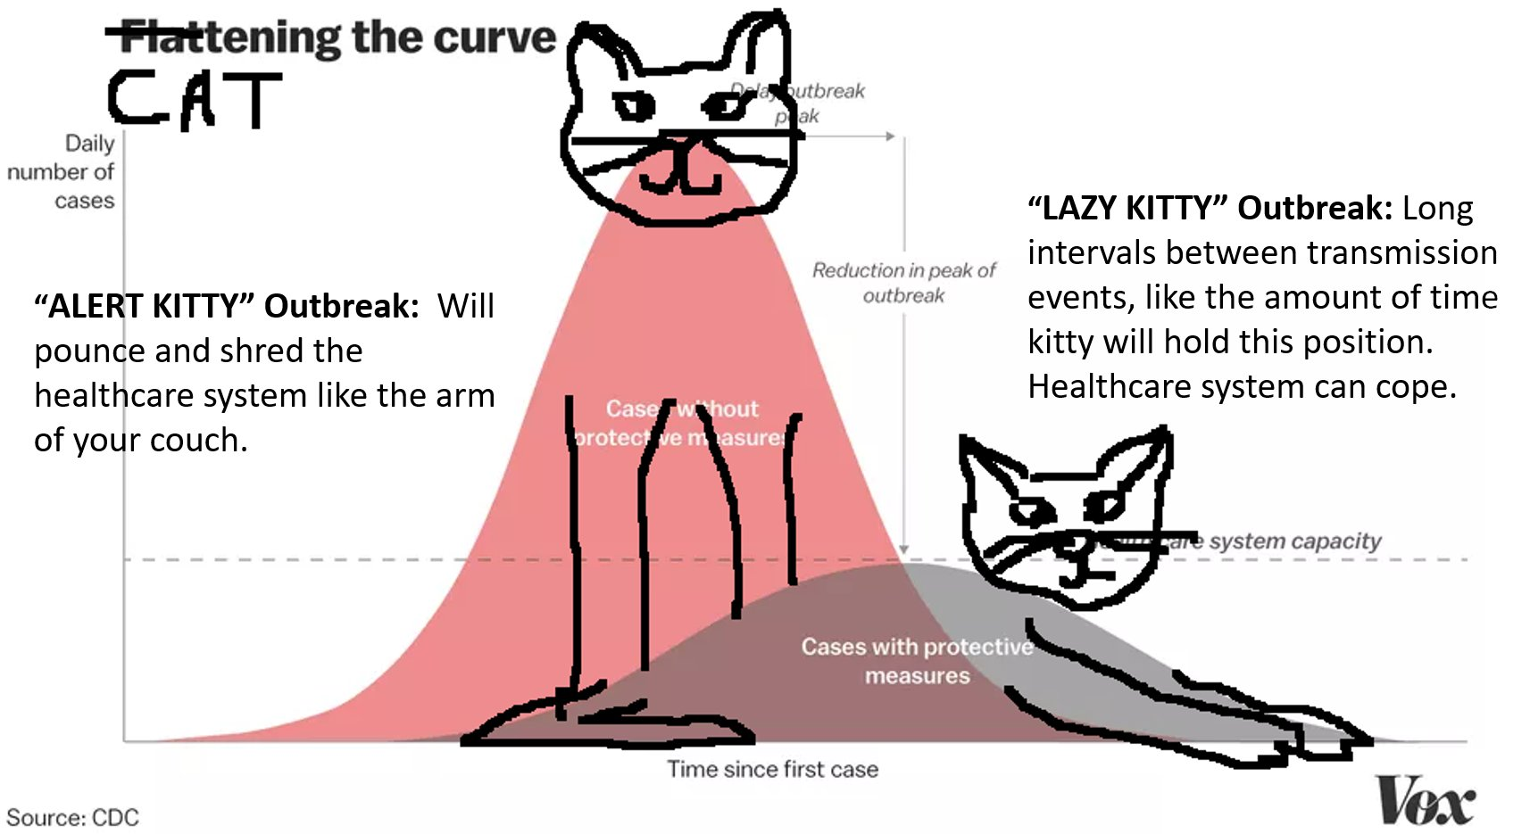
https://twitter.com/amdar1ing/status/1237880129575157760/photo/1
Notes:
Count how many times you’ve thought about charts in the last few weeks. If you can’t think of a time, let me remind you of the phrase, “flatten the curve.” This phrase has been tossed around so many times these past weeks, it’s already been memed (see slide).
I could spend a lot of time telling you why data visualization is important, but that would be a waste: you already know; you’re here.
What I do want to say is this: it’s time for data visualizations--proper, accessible data visualizations--to be more routinely included in our content management, just like images or video. For that to happen, we need to make it easy for every-day users to create their own charts. And, because Drupal feels like home [you know, that place we’re all stuck], I want people to be able to create these visualizations without needing to leave Drupal.

Slide 5
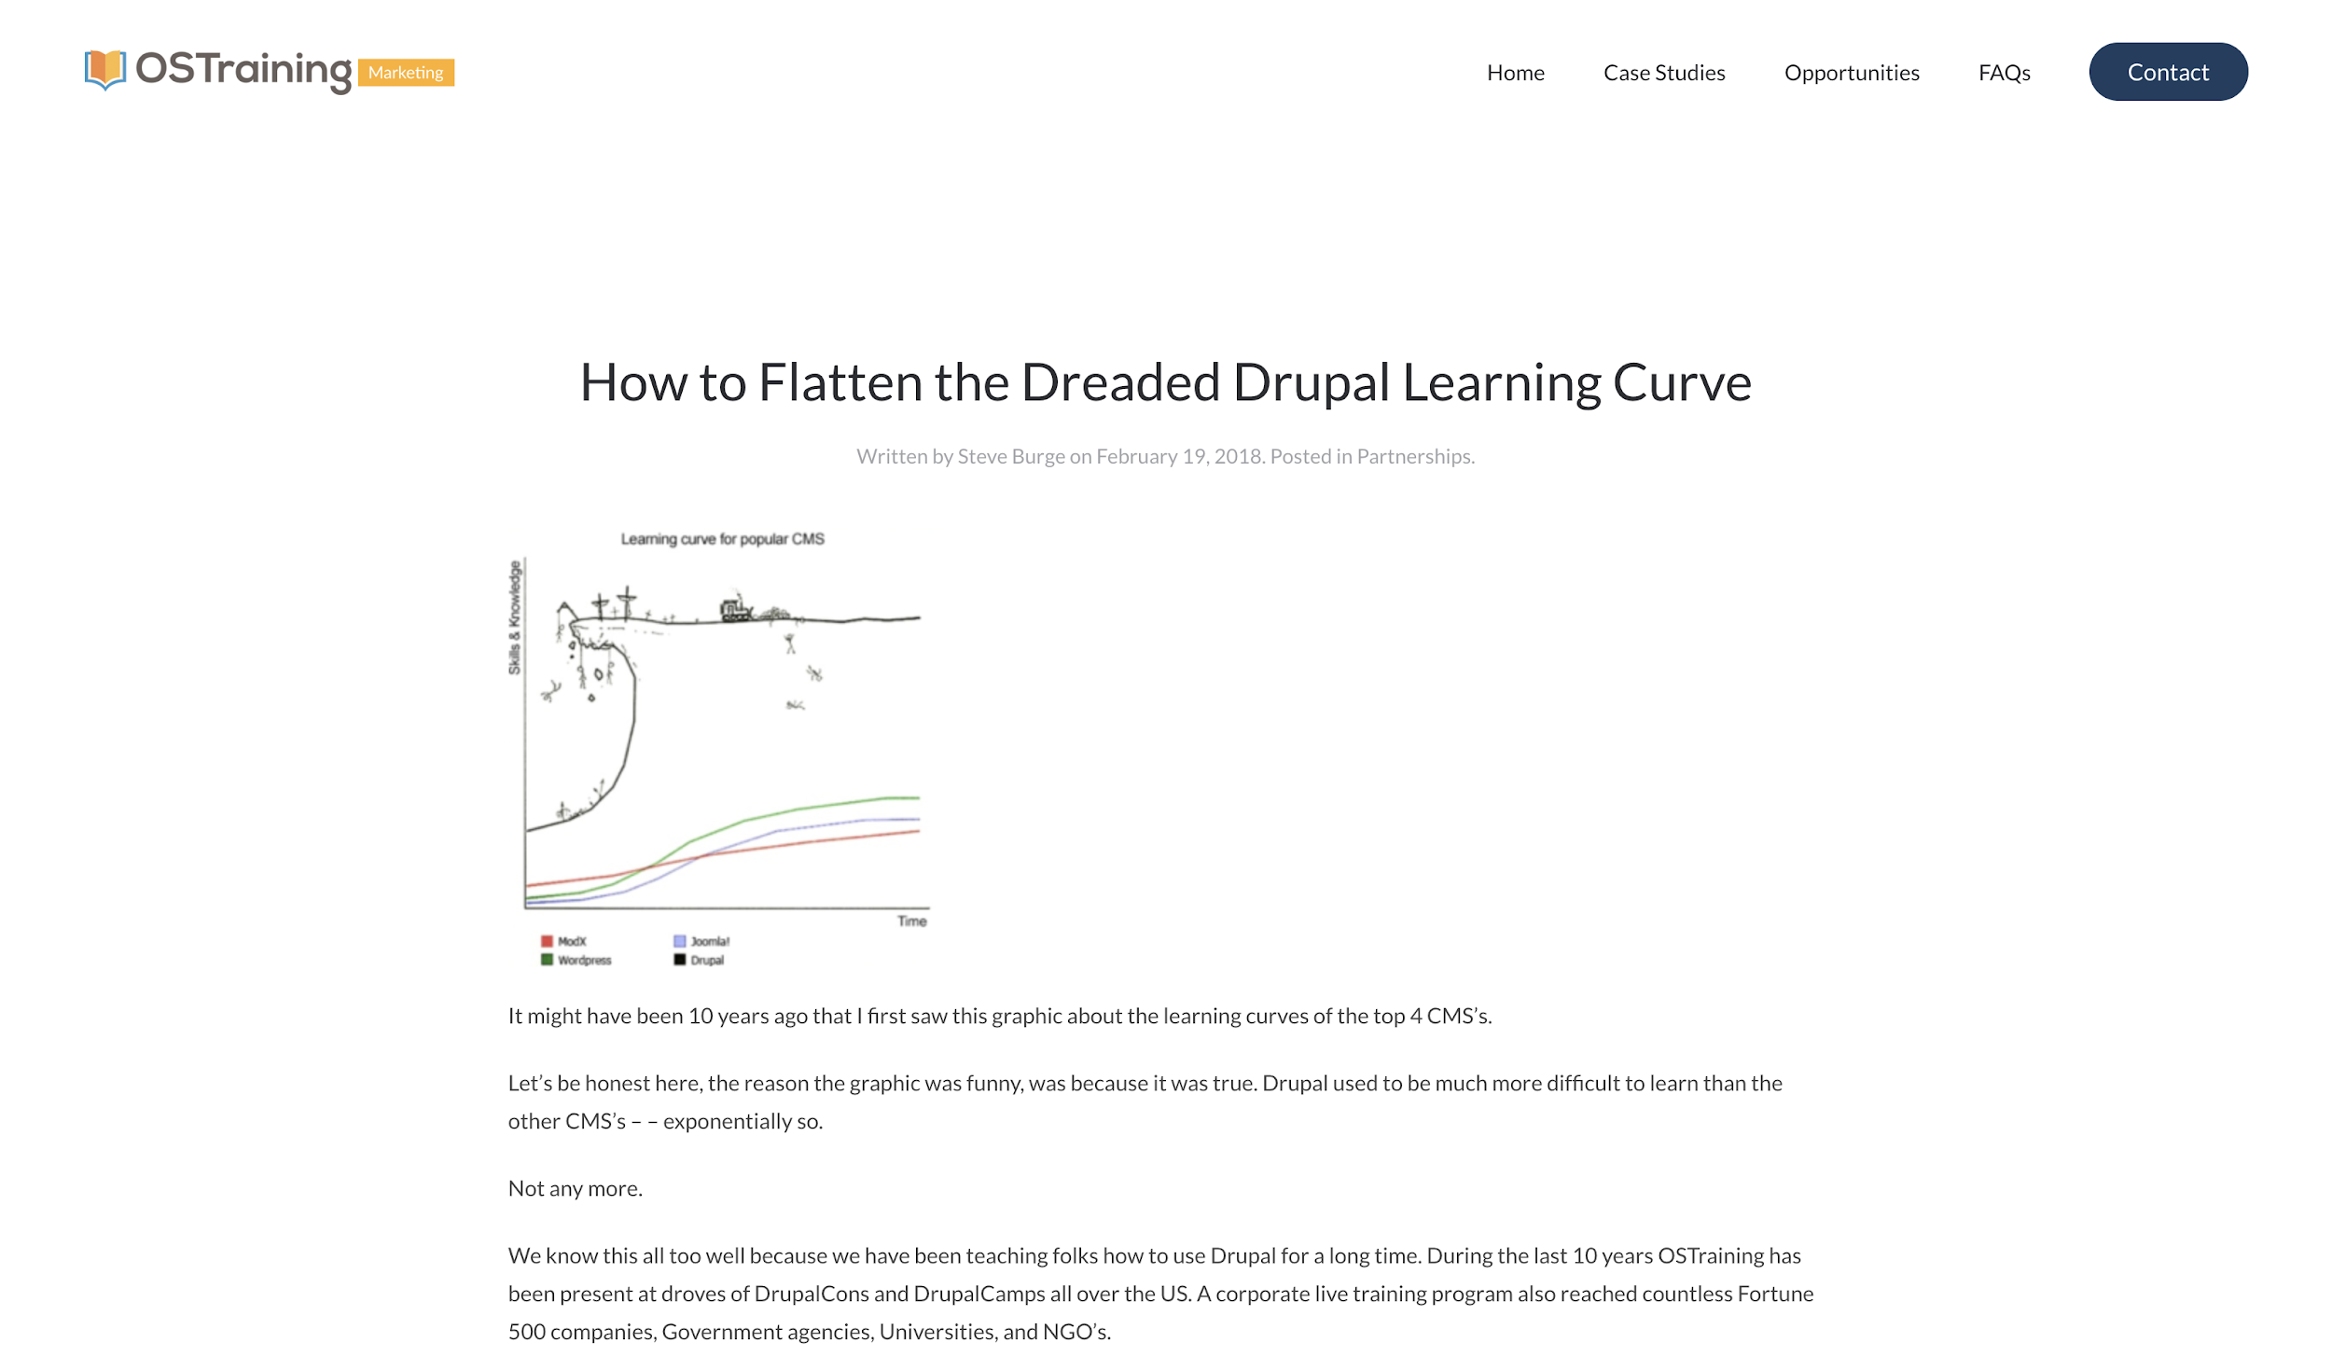
https://www.dropbox.com/s/kjdvi3ig6q67cz7/Screenshot%202020-03-16%2021.40.44.png?dl=0
Notes:
By the way, the Drupal community was talking about “flattening the curve” YEARS ago.

Slide 6
Introduction
Scenarios
Other Technologies
Discussion
Notes:
In this presentation, I will walk you through a few scenarios involving data visualization and show you how the Charts module can help with each of them.
Are there other technologies that could also do the job? Yes. Will I be covering them? Mostly not. If you were looking for the Consumer Reports of charting technology, well, you’ll probably give me a filled-in black circle at the end of this presentation. Being maintainer of the Charts module, I’m doing everything I can to make it a better, more useful module, including by spreading the word and trying to bring others into the fold.
All that said, I will mention a couple alternatives at the end. I also hope to hear from you: what are you looking for when it comes to data visualization? Please be thinking about that.

Slide 7
Scenarios
Notes:
With that, let’s dive in and look at some scenarios in which you may find yourself. I’ll be assuming that you have the Charts module installed and a charting library in place. I’m also assuming you can install additional modules or have someone who can do that for you.

Slide 8
Scenario 1: I want a dashboard!

Slide 9
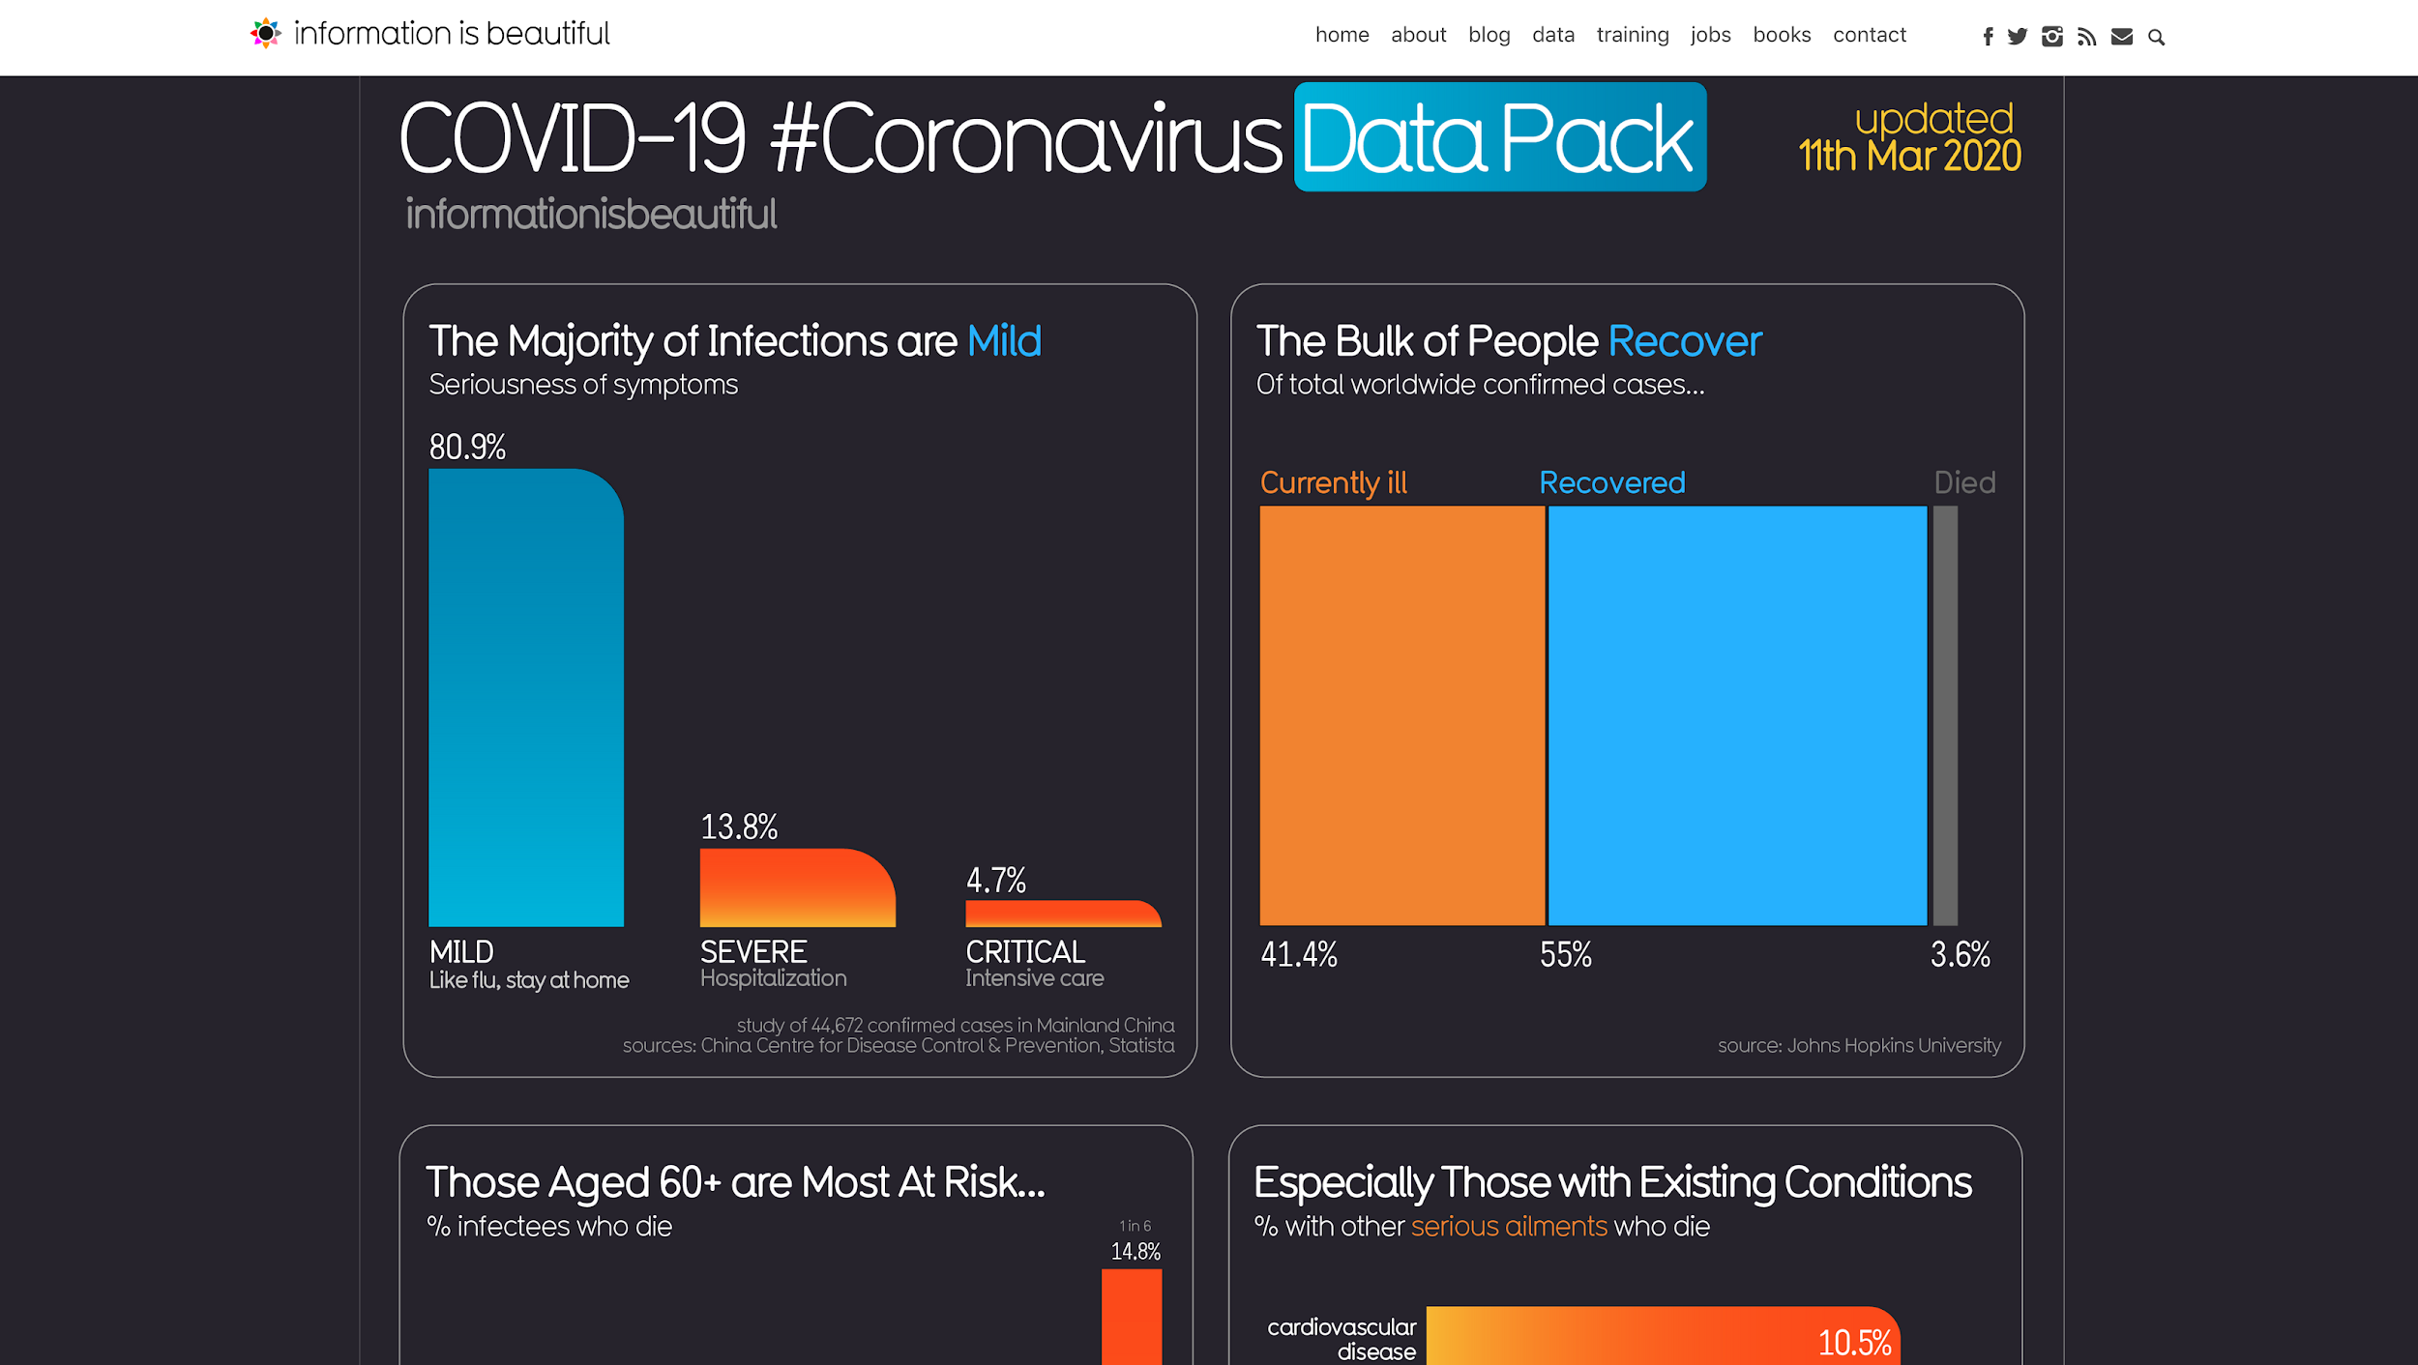
https://informationisbeautiful.net/visualizations/covid-19-coronavirus-infographic-datapack/?
Notes:
My company being a public health company, following links about COVID-19 was not just something we did during lunch break. We also have a “dataviz” listserv, and that’s where I first saw the controversial Information is Beautiful “data pack” about COVID-19. My first thought? I could build this dashboard using the Charts module.

Slide 10
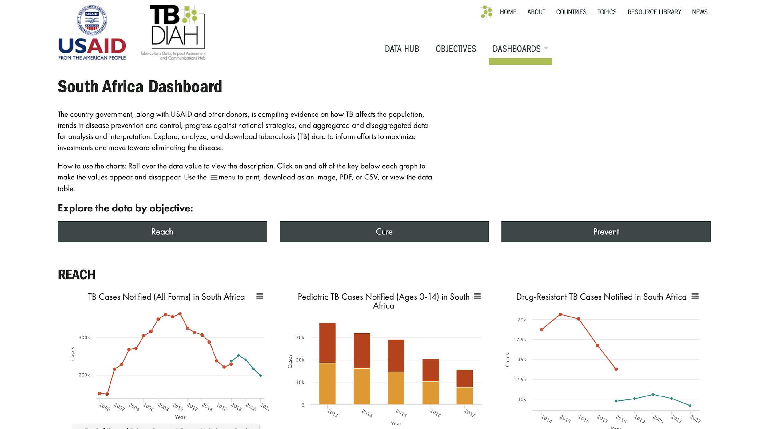
My clients and colleagues… found something worth investigating nearly every time we looked at these charts together.
https://hub.tbdiah.org
Notes:
A data dashboard is a common ask at my company. Last year, when I presented at MidCamp, I had finished a dashboard on Tuberculosis (TB) data the day before. I’ve also built dashboards for tracking rollout of an injectable contraceptive known as Sayana® Press, tracking communication campaigns around HIV, and tracking indicators around project performance.
The data in the TB dashboard pictured on this slide are primarily from WHO, and they’ve been releasing updates to these data (in the form of massive CSV files) each year for probably at least a decade. My clients and colleagues who worked with me on these dashboards have been studying TB and monitoring health systems for years, but they found something worth investigating nearly every time we looked at these charts together.
Charts makes it relatively easy to build dashboards within Drupal. Let’s walk through two options for doing this.

Slide 11
Option 1: Use Layout Builder and Charts Blocks or Views
Pros:
Layout Builder is built into Core
Options for per-bundle or -entity templates
Cons:
Settings Tray too small by default
Some popular themes are incompatible
Notes:
Option 1 (which is probably where I would rank this option) is to use Layout Builder in combination with Charts Fields, Charts Blocks, or Charts Views. I was slow to jump on the Layout Builder train because I was using a theme that doesn’t work well with Layout Builder, but once I started using it, I’ve found it to be a solid option. The fact that it’s built into Core is a great bonus. You can set up layouts for a whole bundle (e.g. content type) or on a per-entity basis.
While I was preparing for this presentation, I did find a few drawbacks. First: the settings tray, which is how you would normally add an item to the layout, is too narrow. It can’t contain the table data entry that comes with the most recent version of Charts. I also ended up needing to add a line of CSS in order for my charts to stay in the same row - that may be unique to Layout Builder’s use with Charts and would likely be an easy bug to fix.

Slide 12
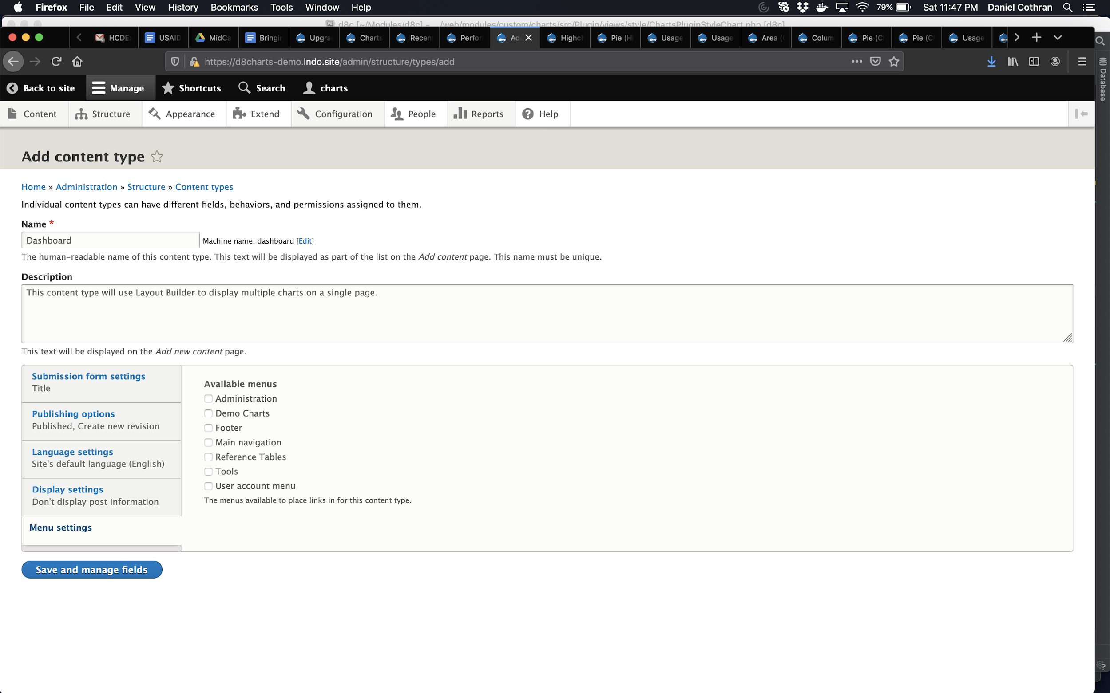
Step 1:
Create a “Dashboard” content type

Slide 13
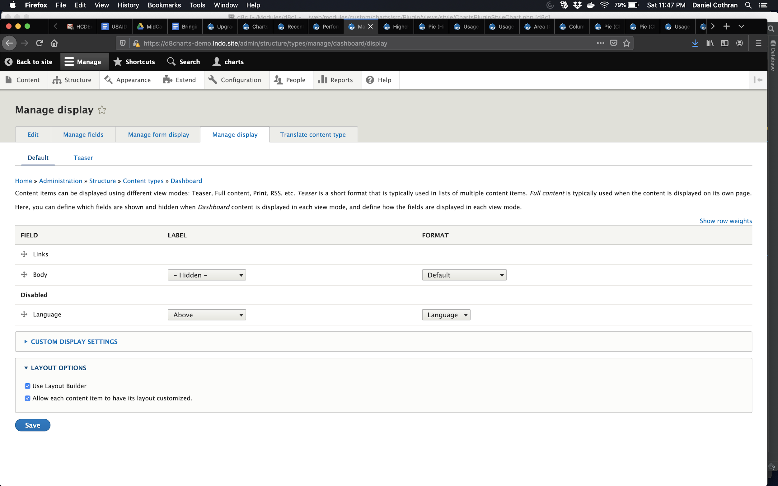
Step 2:
Manage the display of that content type to enable Layout Builder

Slide 14
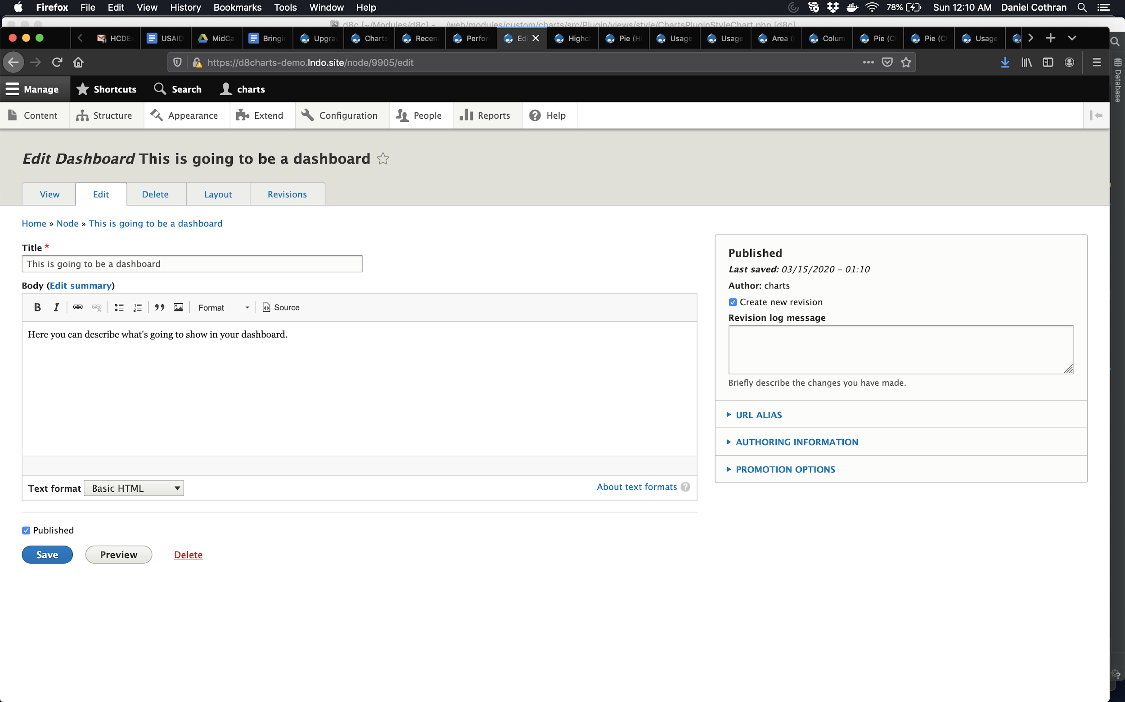
Step 3:
Create a “Dashboard” node

Slide 15
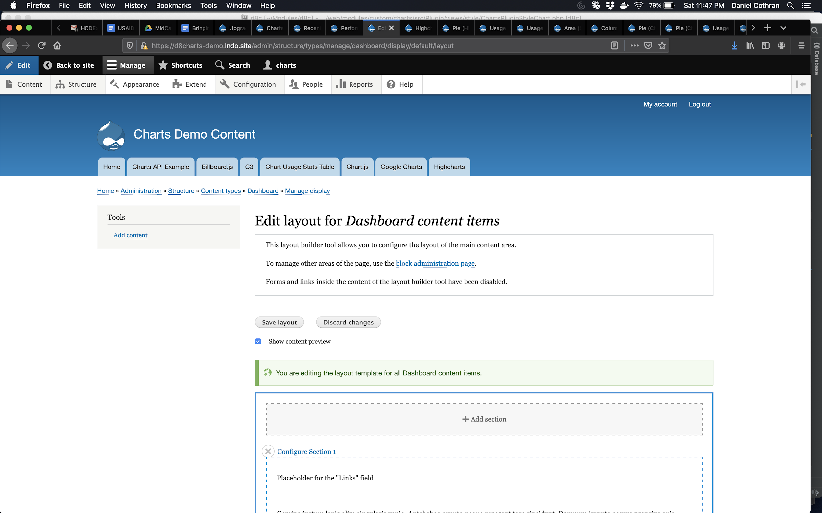
Step 4:
Edit the layout of the node

Slide 16
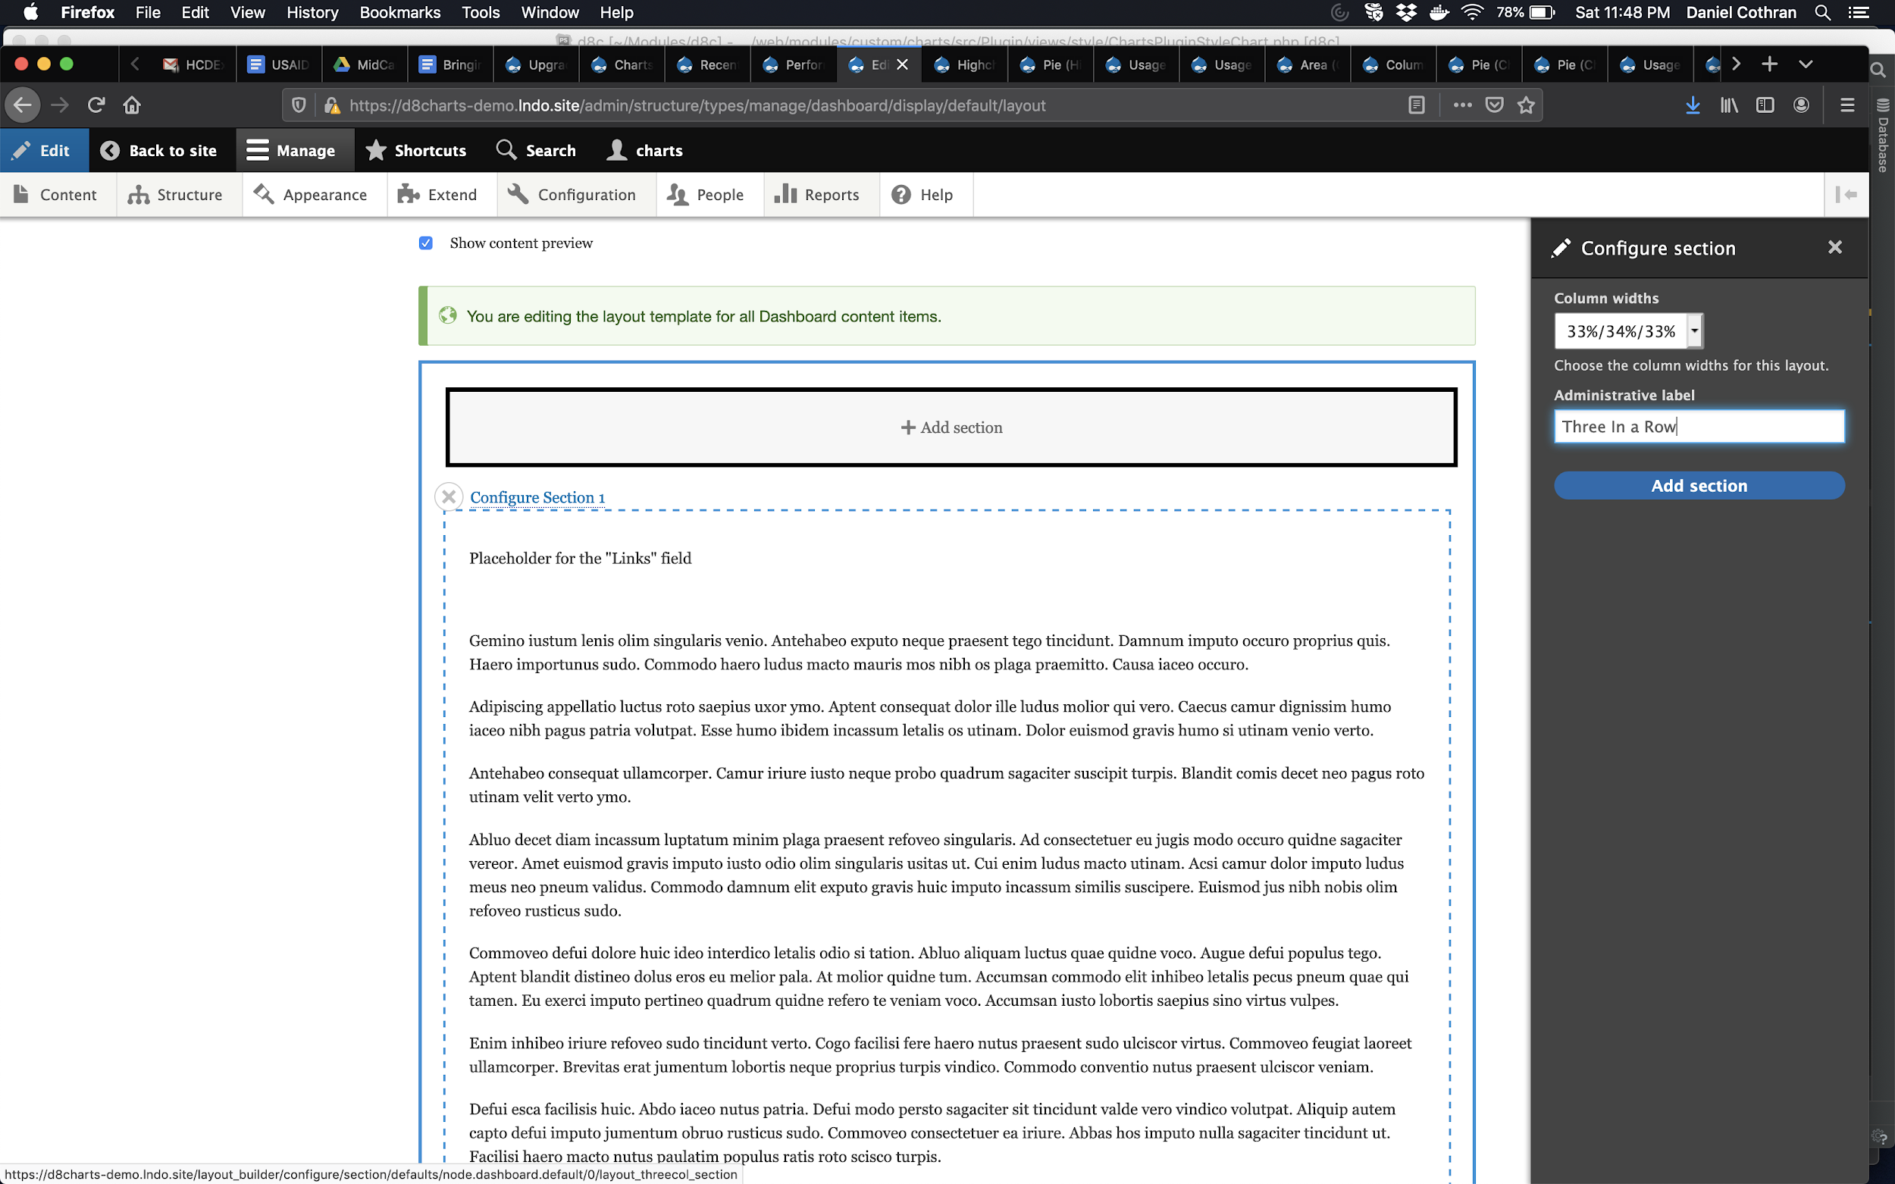
Step 5:
Add a section to your layout. I chose a three-column grid.

Slide 17
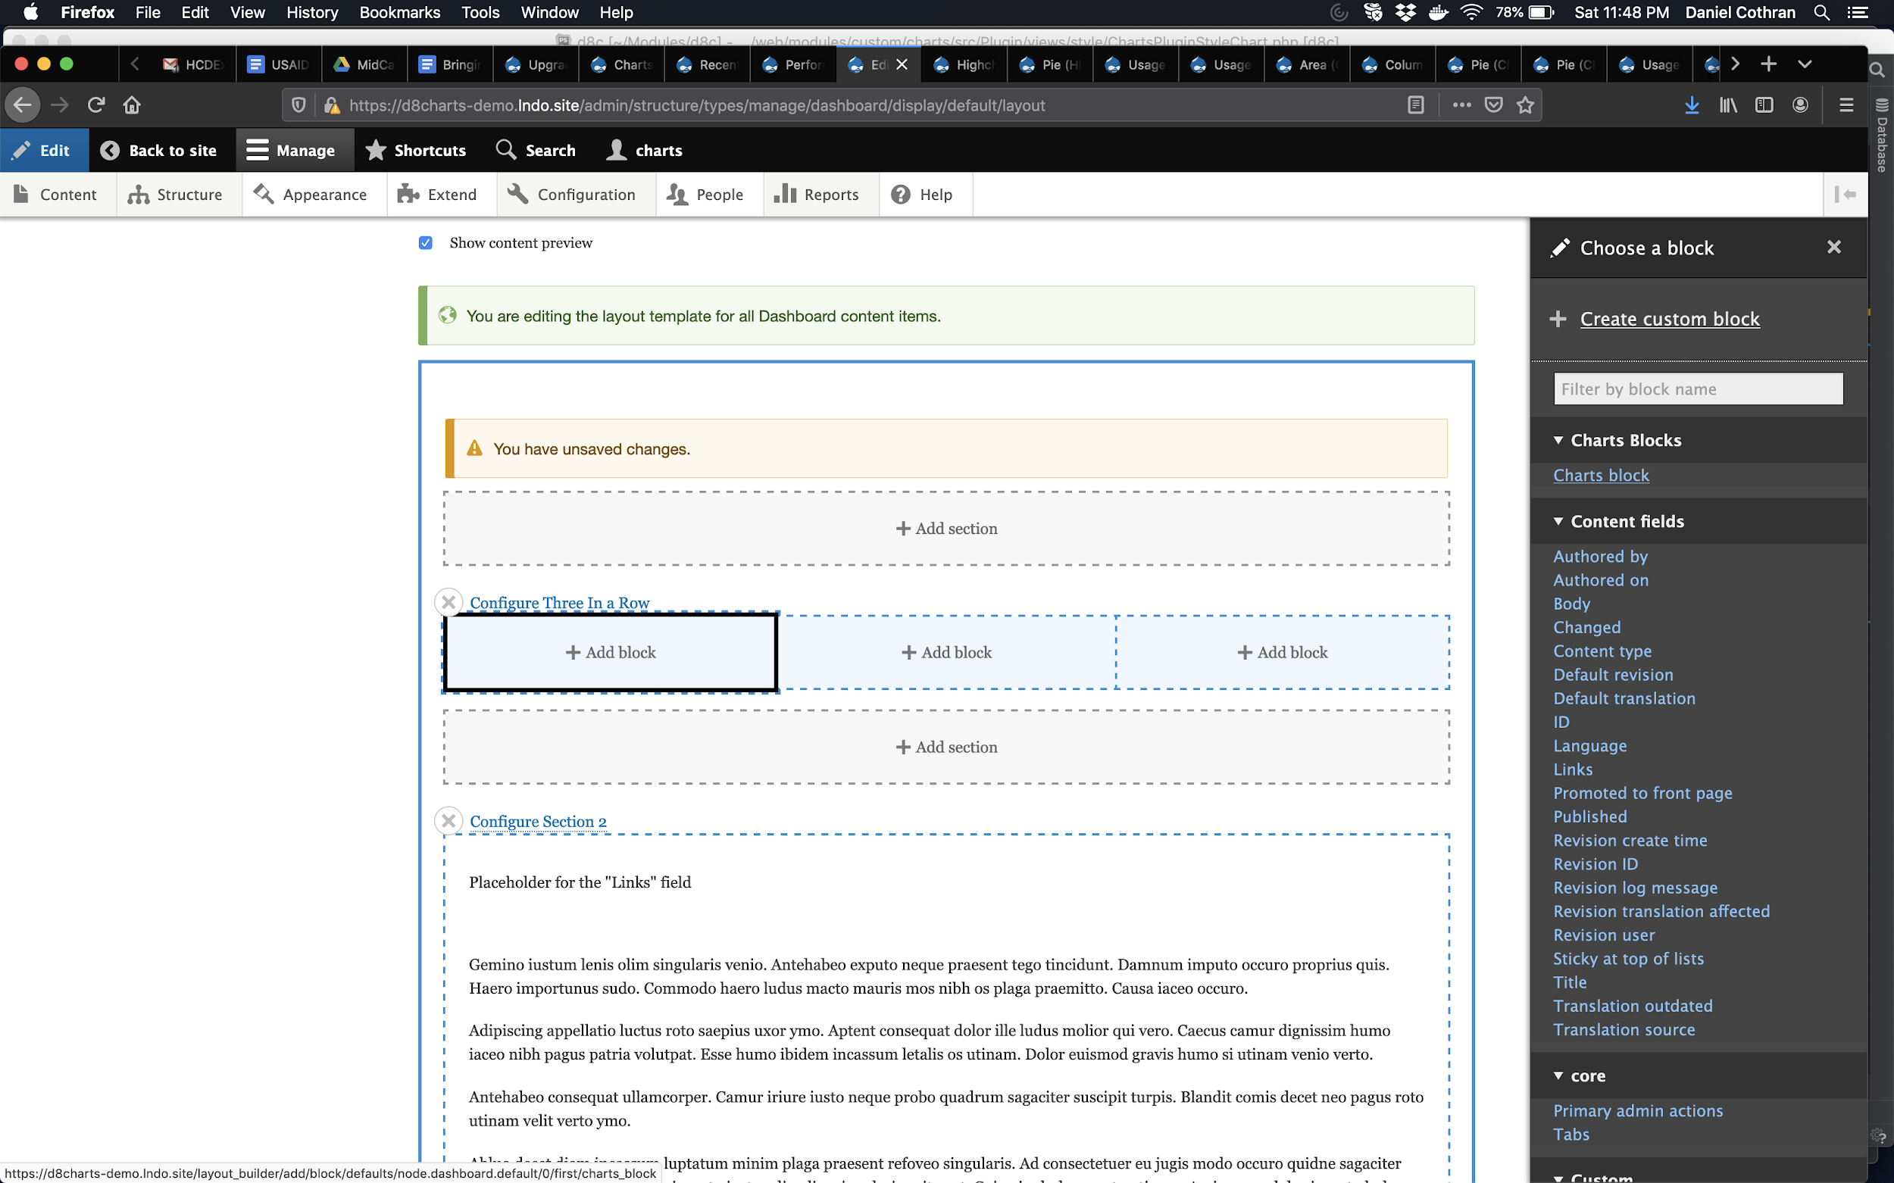
Step 6:
Add a block to your layout

Slide 18
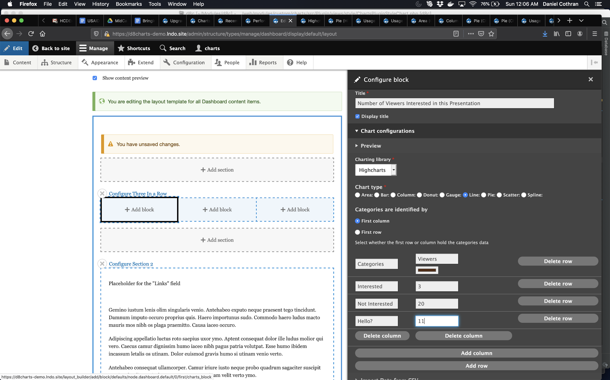
Step 7:
Configure your Charts block (I manually adjusted the width of the settings tray)

Slide 19
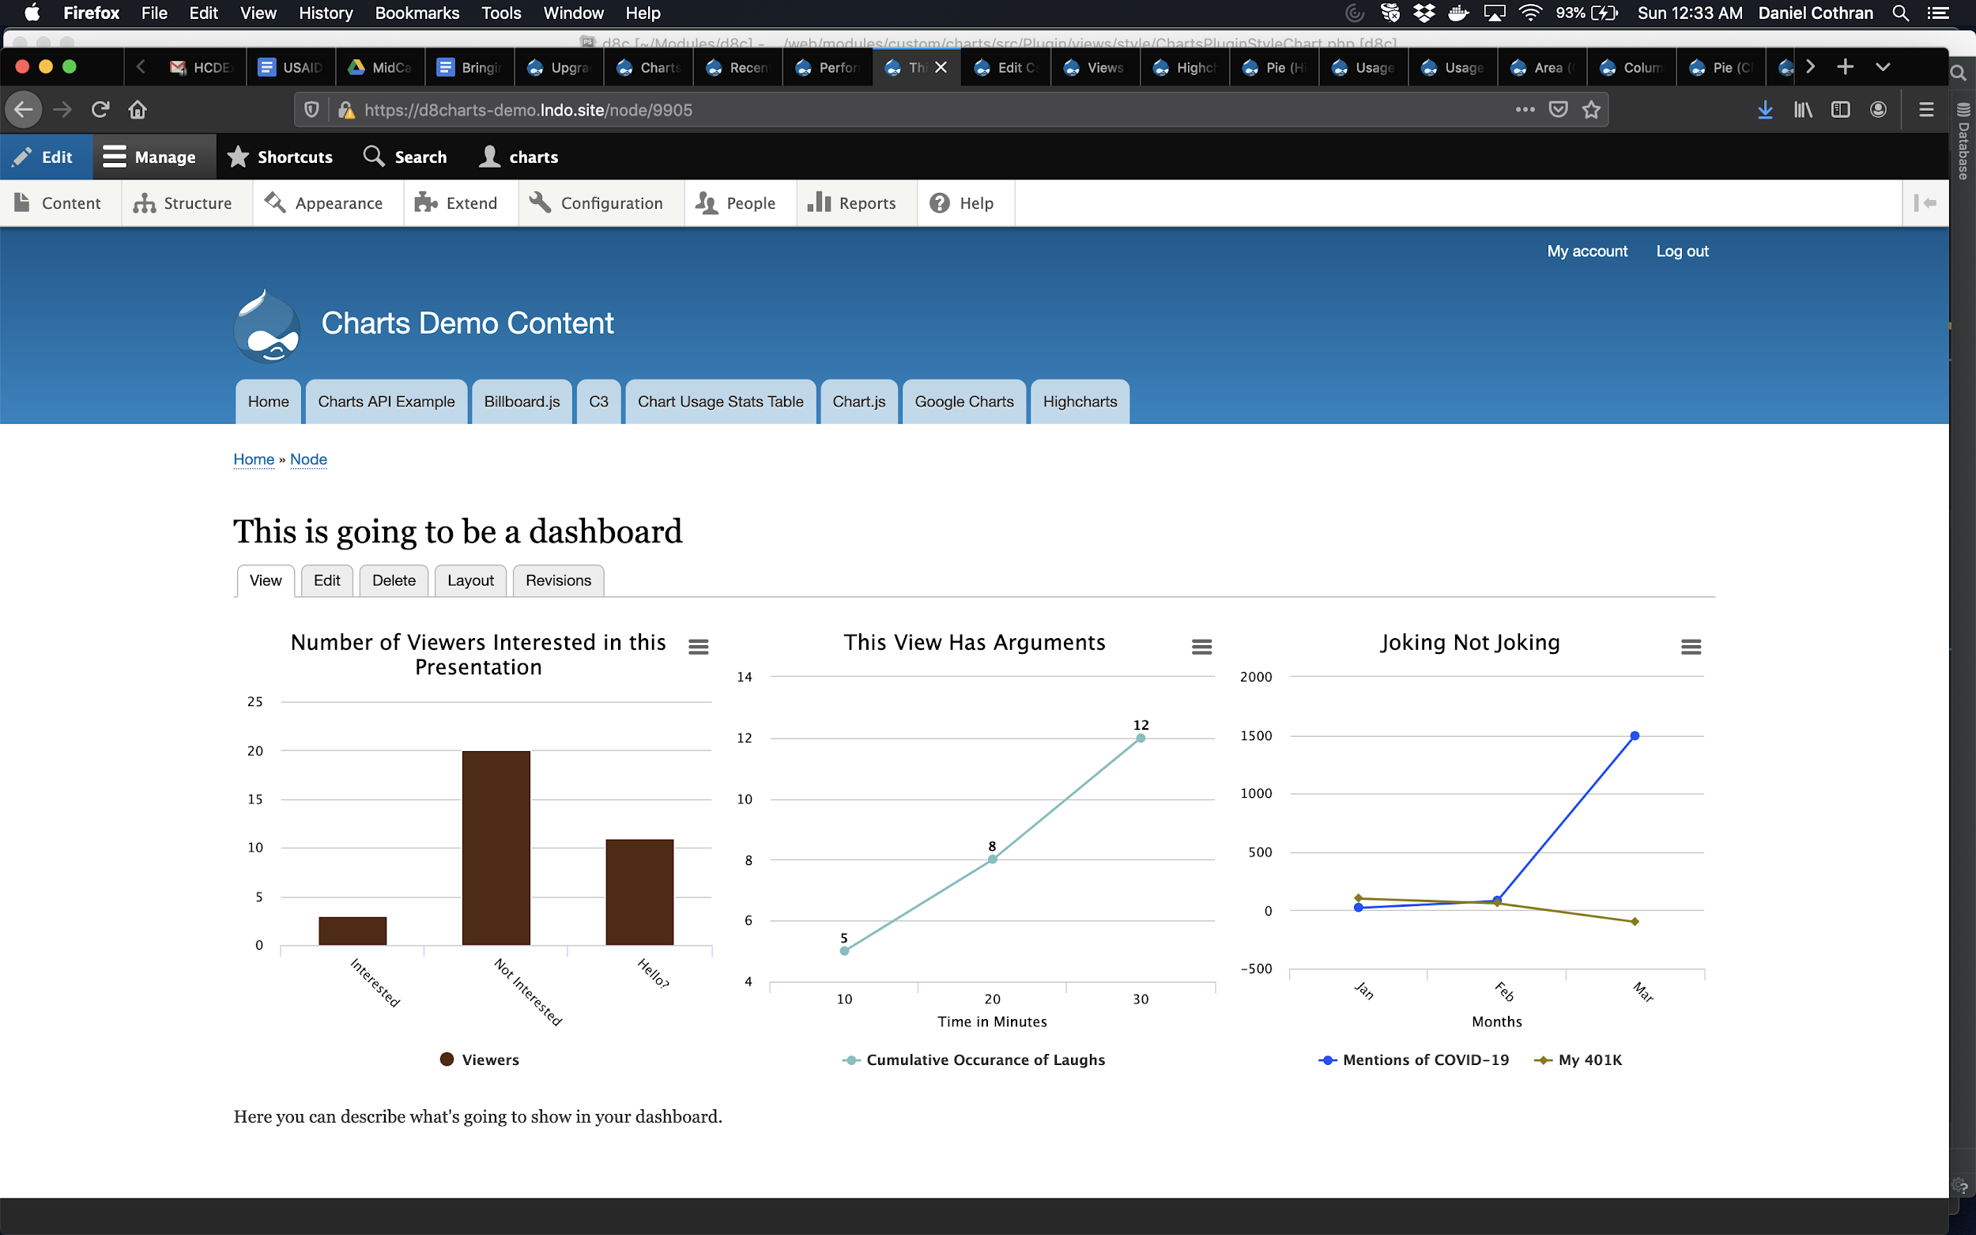
Step 8:
After adding all your charts, admire your handiwork

Slide 20
Types of Charts You Can Include:
Charts Blocks
Charts Fields
Charts Views
Contextual Filters
Exposed Filters

Slide 21
Option 2: Use Paragraphs and Chart Fields
Pros:
More familiar editing experience
Potentially more reusable
Cons:
Paragraphs is contrib
Notes:
The second option is to use Paragraphs and Chart Fields… and you can actually use Layout Builder for your Paragraph display if you want to.
Because with Paragraphs you are generally working within the node edit page, it offers more room for the Charts configuration form than the Settings Tray of Layout Builder. This may also be a more familiar way of adding content for long-time Drupal content managers. Because you’re setting up paragraph entities, there may also be more extensibility or reusability by going with Option 2. However, the likelihood that you would have more than a few design patterns seems low.
A potential drawback to using this option is that Paragraphs is a big, complex contributed module. It can work really well, but it can also be hard to manage.

Slide 22
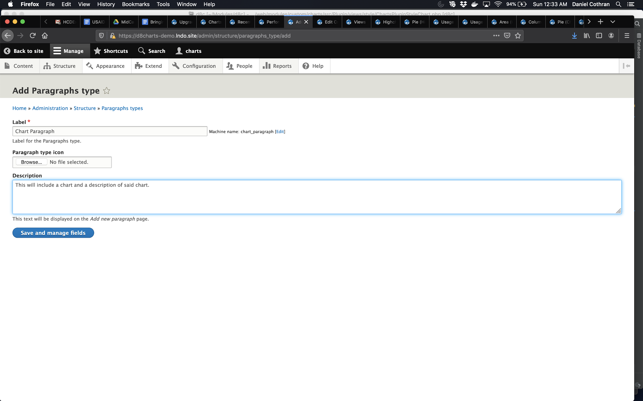
Step 1:
Add a Paragraph type

Slide 23
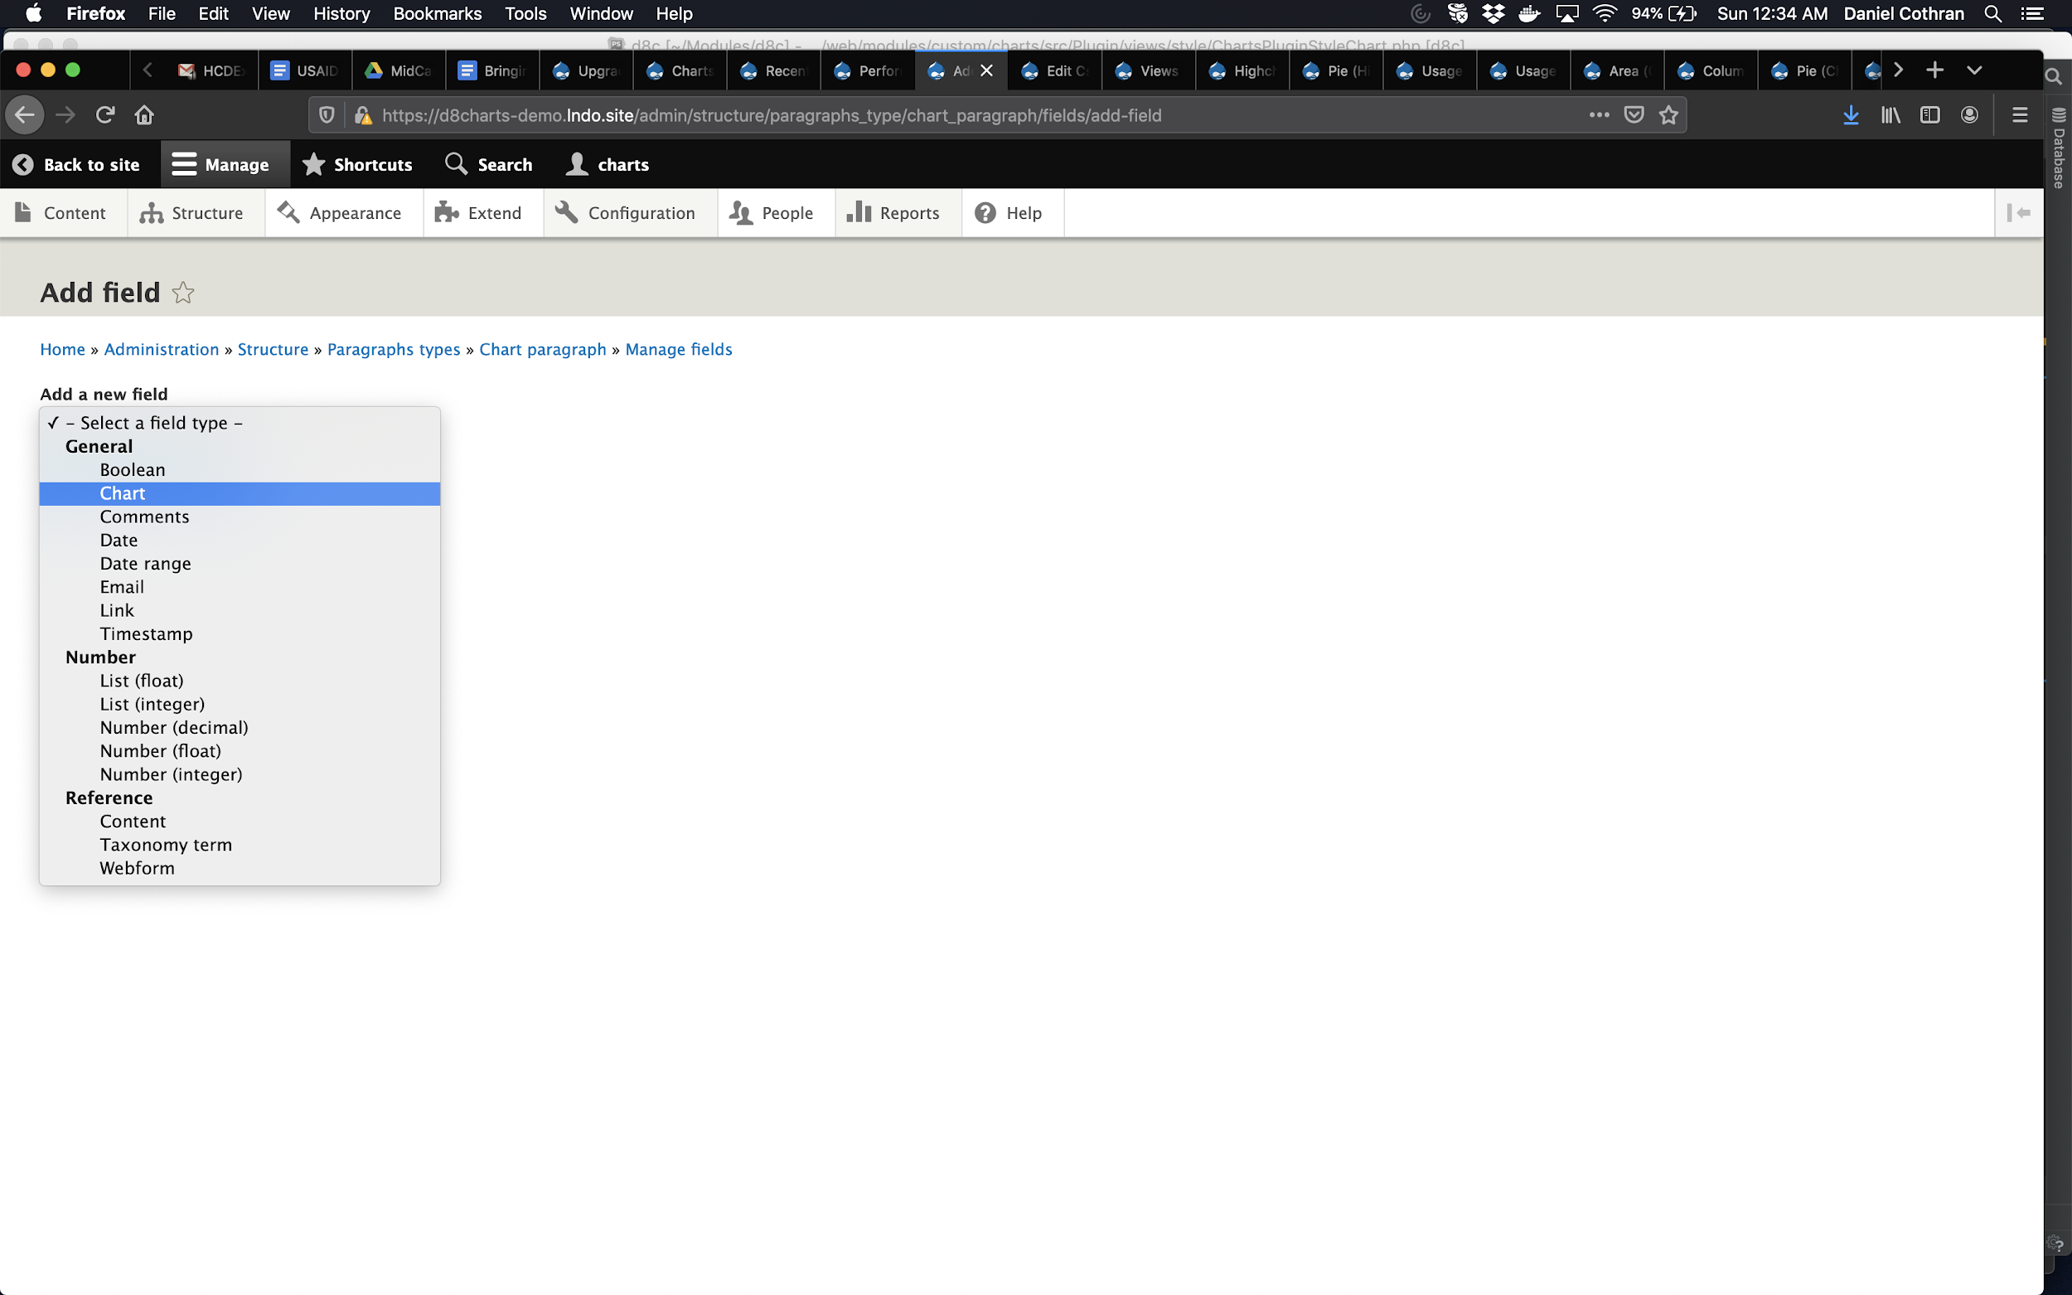
Step 2:
Add a Chart field to the Paragraph

Slide 24
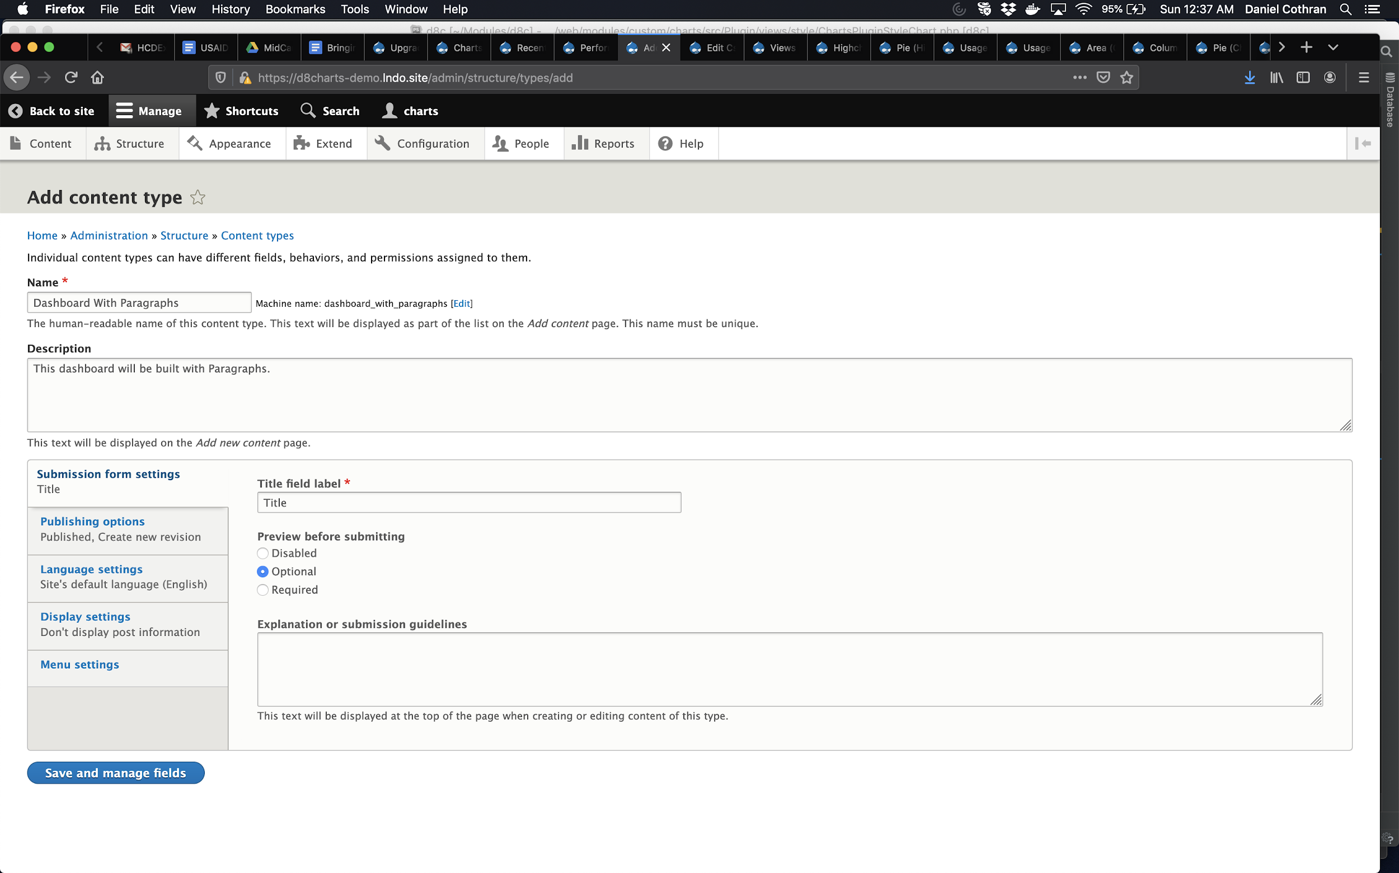
Step 3:
Add a content type that uses Paragraphs

Slide 25
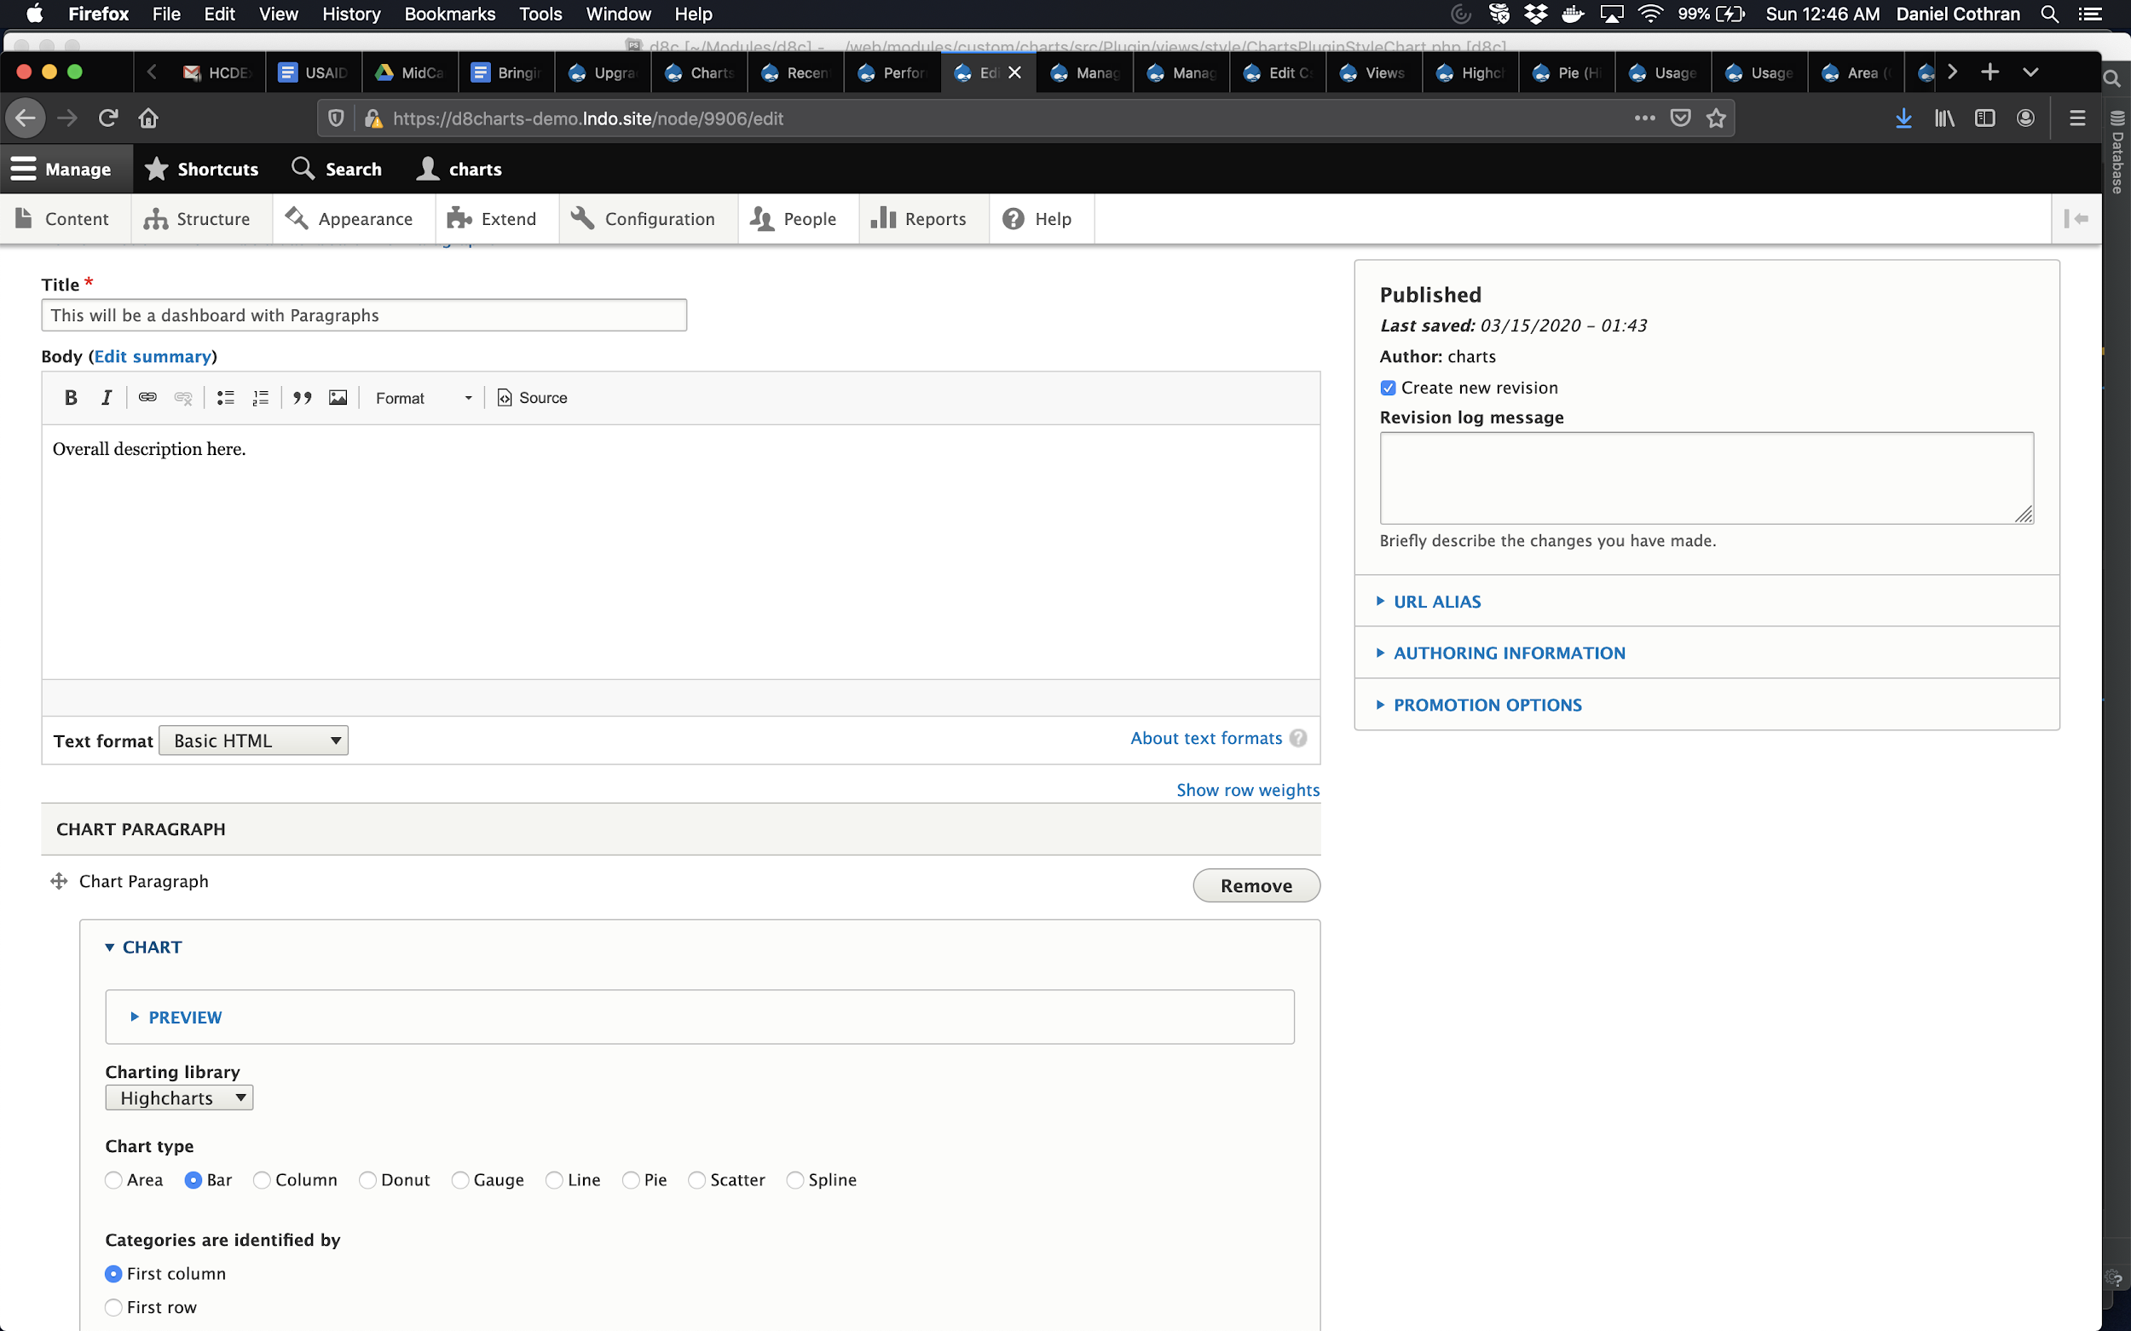
Step 4:
Create a node, adding data to your Chart field

Slide 26
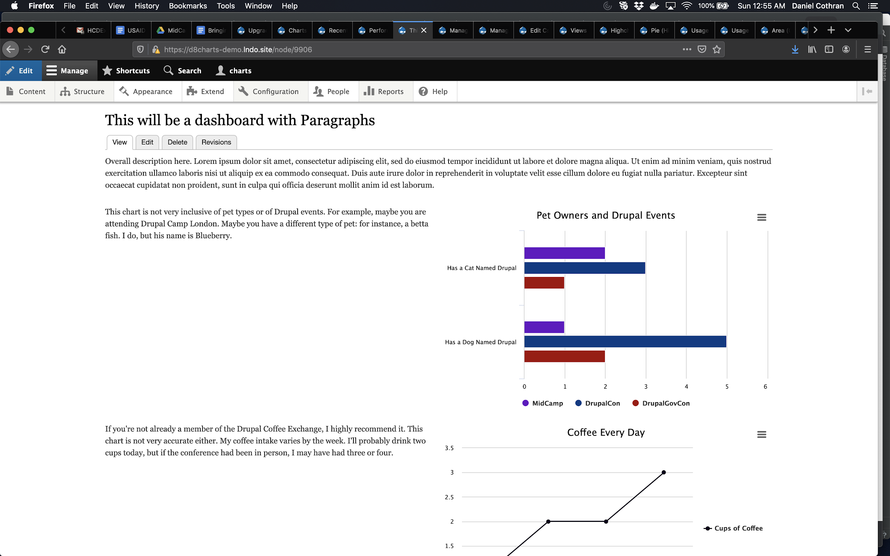
Step 5:
After adding all your Paragraphs with charts, admire your handiwork

Slide 27
Scenario 2: I want to display the results of a Webform survey!

Slide 28

It’s Census season, and surveys haven’t been this popular in 10 years.
https://www.census.gov/en.html
Notes:
The Drupal community has an amazing tool for surveys: the Webform module. There are many good reasons to have users submit a Webform rather than publish a node: no need for account sign-up; the permissions are a little easier to manage; and the interface is better.
A nice feature in certain circumstances is to display the user’s results back to them after submission, either just their results, or their results incorporated with all the other results. This can encourage users to submit, especially if we’re talking about routine data collection, which is an important type of data collection the public health field.
Charts can be a great way to allow users to see that their inputs were important and to encourage participation in routine data collection. There are at least a couple ways of generating charts from Webform results... without the need to write code.

Slide 29
Option 1: Webform and Webform Views
Pros:
You don’t need any additional entities
Cons:
Webform Views fields’ naming convention
The data structure of a Webform table isn’t always the best for charting
Notes:
I almost always use Views to construct the charts on my site. So when trying to plot Webform results, using the Webform Views module would be my first instinct. The great thing about this option is that you can keep your data in the Webform results table, and you can build Charts how you normally would. However, you have to be really thoughtful about what you’re looking for in order for this to be a viable option. The Webform Views module also has an unpleasant naming convention. Instead of the field name, you get webform_submission_value, webform_submission_value_1, webform_submission_value_2, etc. It can just be a little less user-friendly.

Slide 30
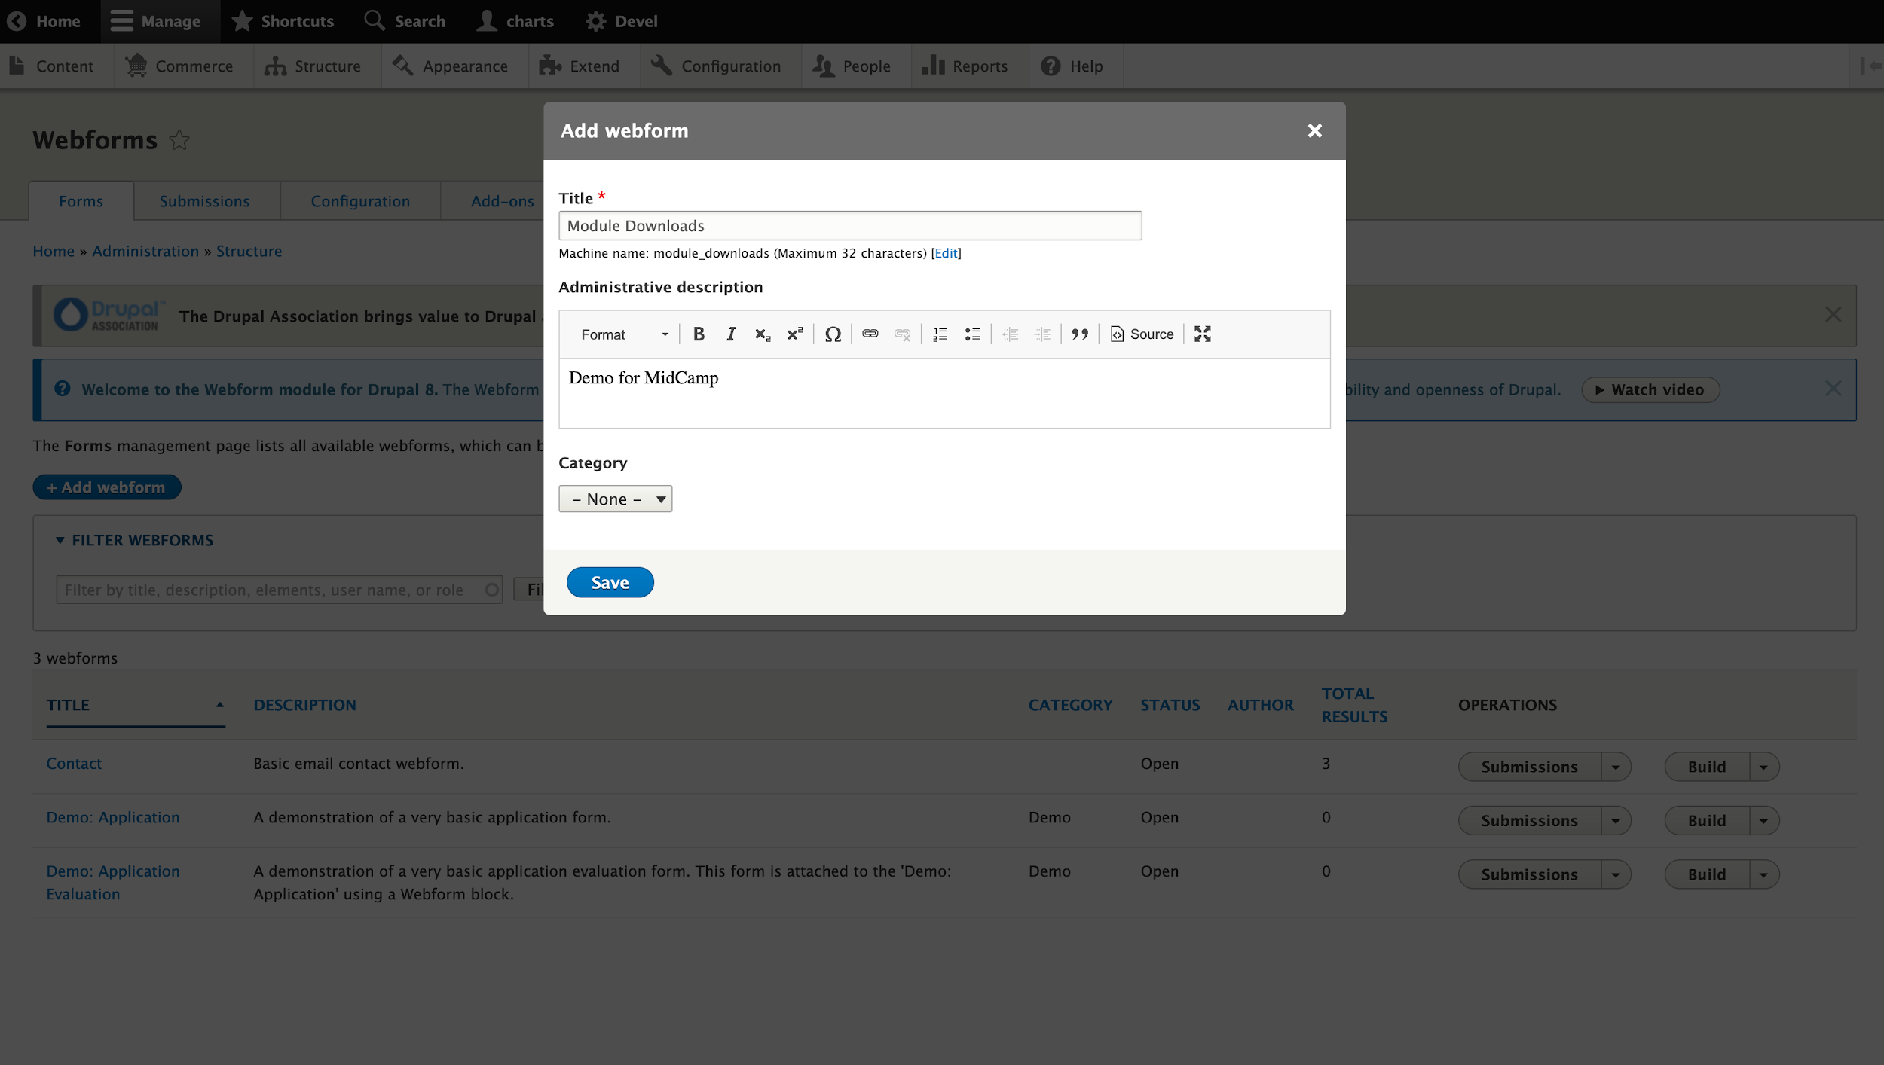
Step 1:
Create a Webform

Slide 31
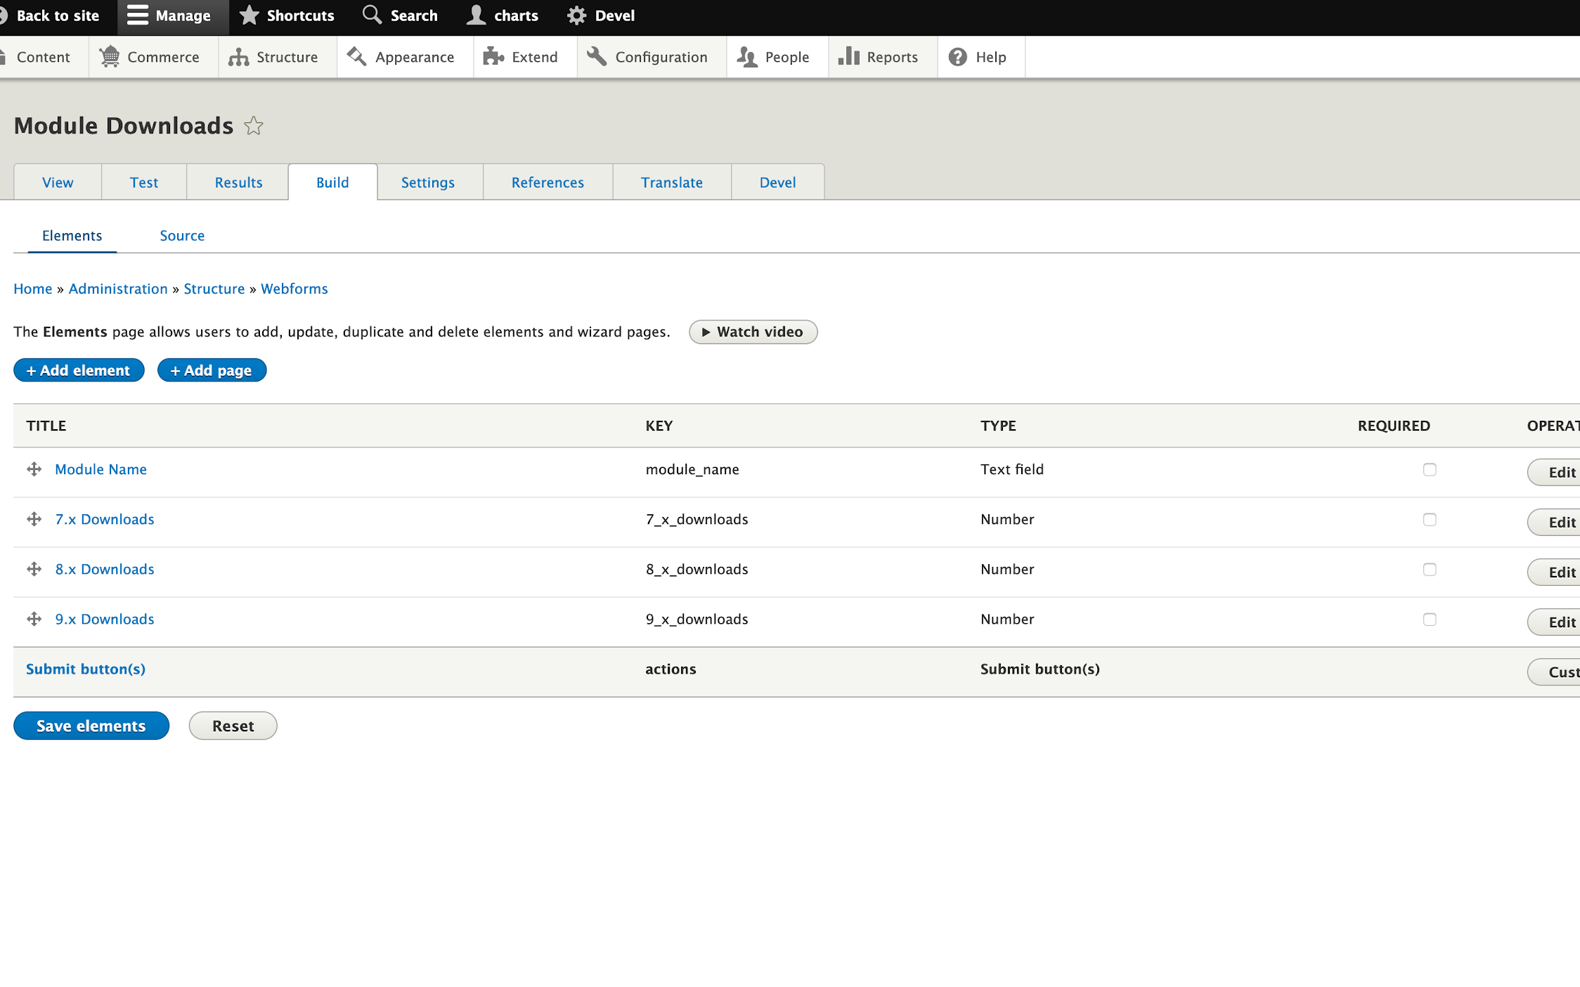
Step 2:
Add at least one number-type field

Slide 32
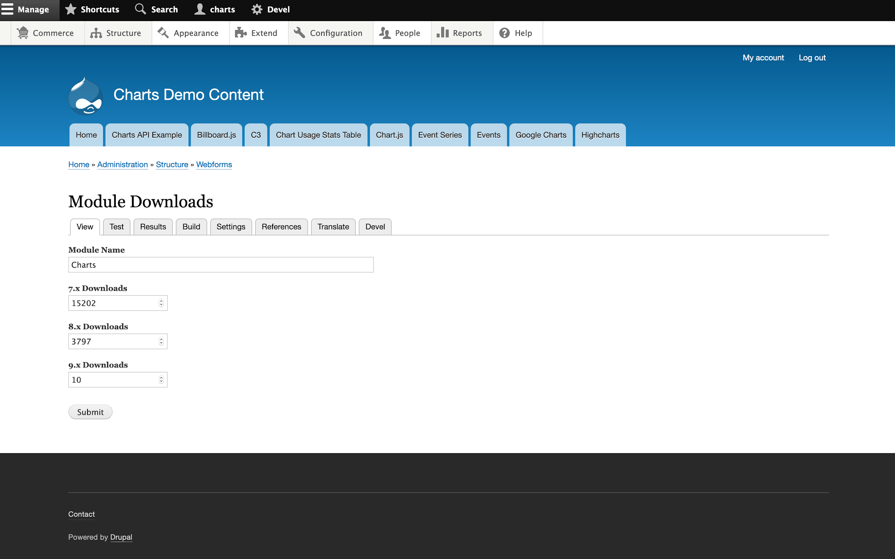
Step 3:
Submit to the form

Slide 33
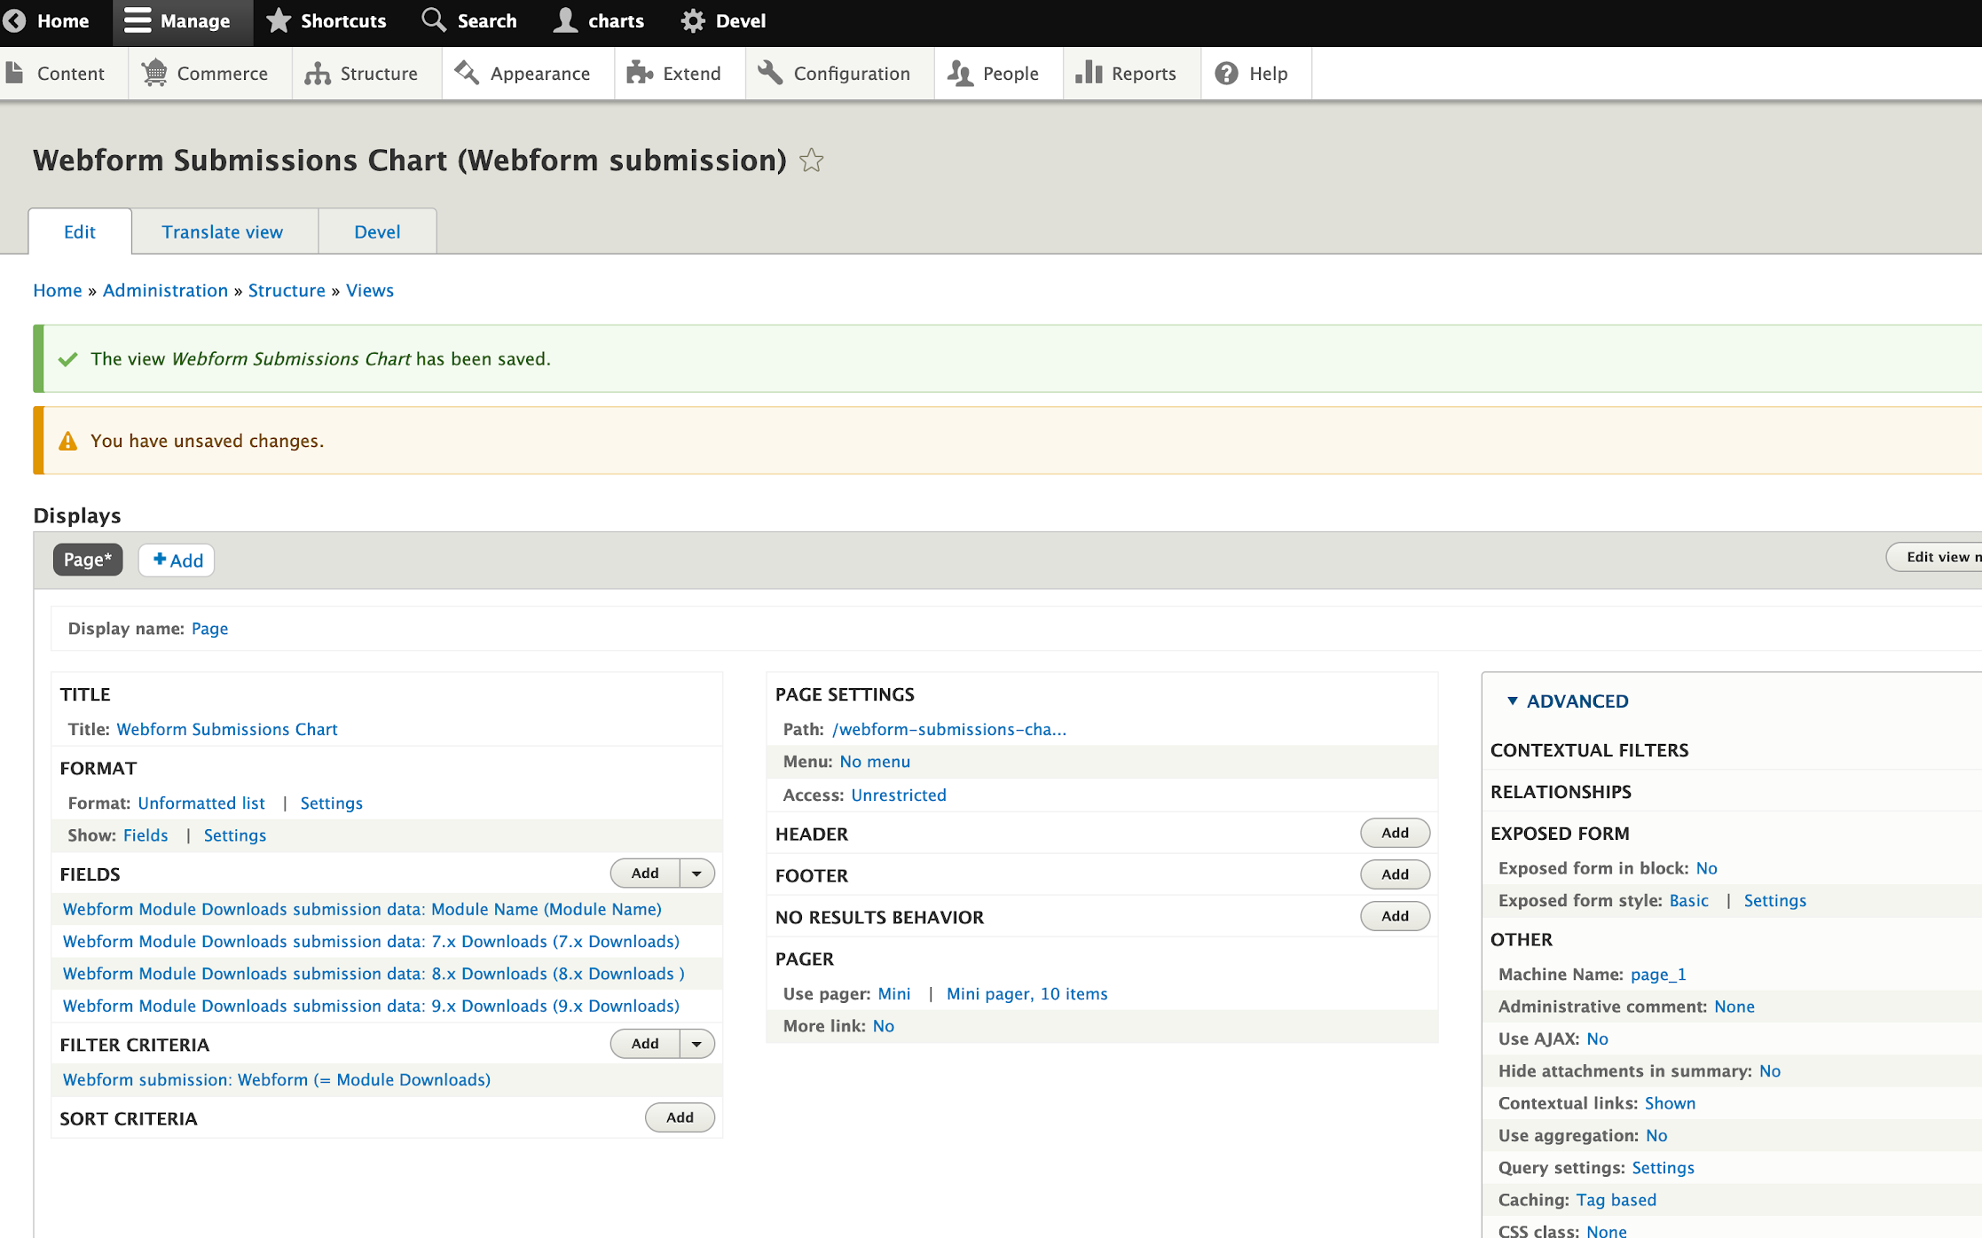
Step 4:
Create a View of Webform Submissions

Slide 34
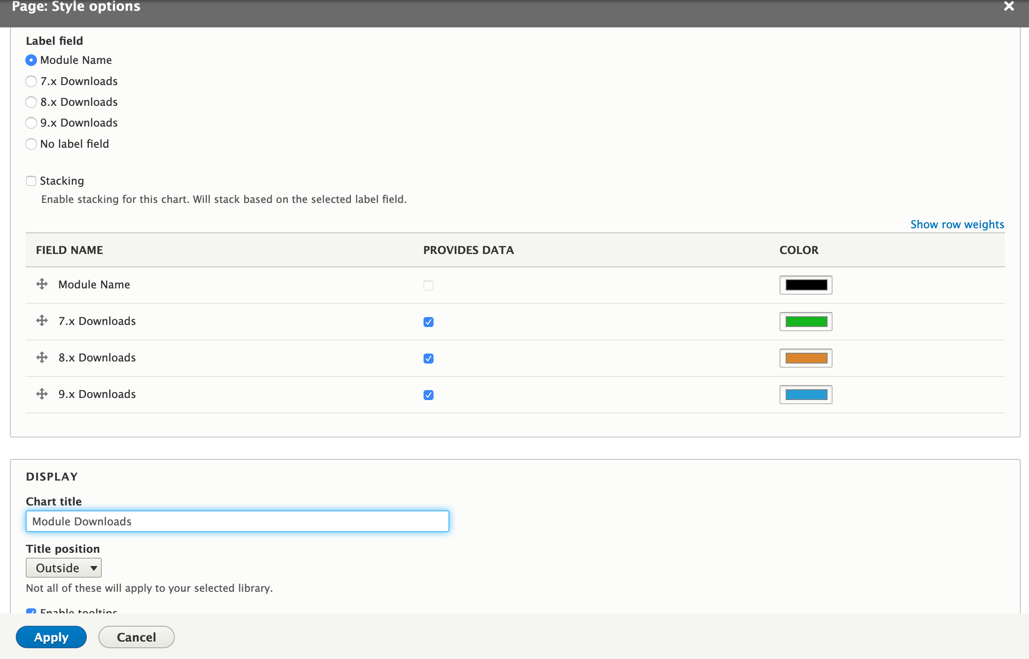
Step 5:
Configure the Chart format settings

Slide 35
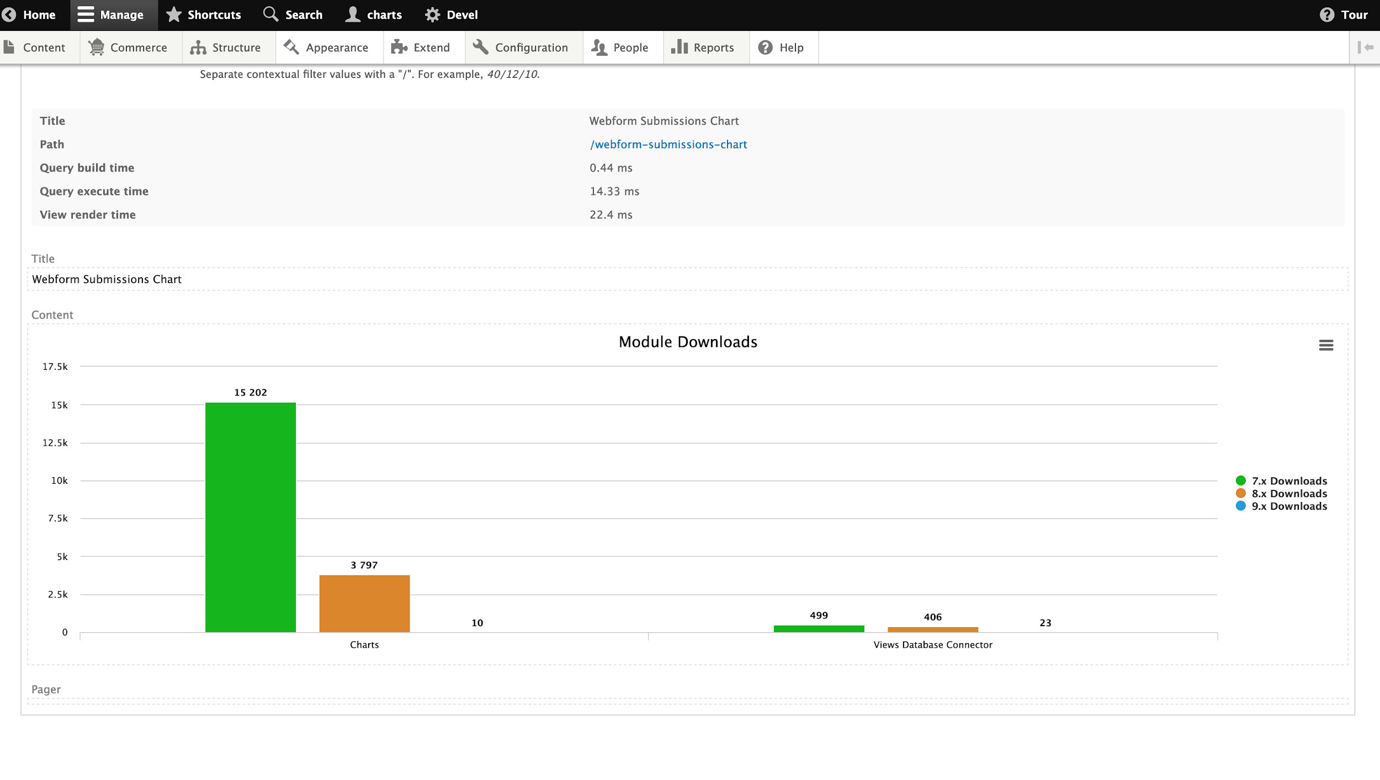
Result 1:
Each cluster represents a row in the Webform Submissions results table

Slide 36
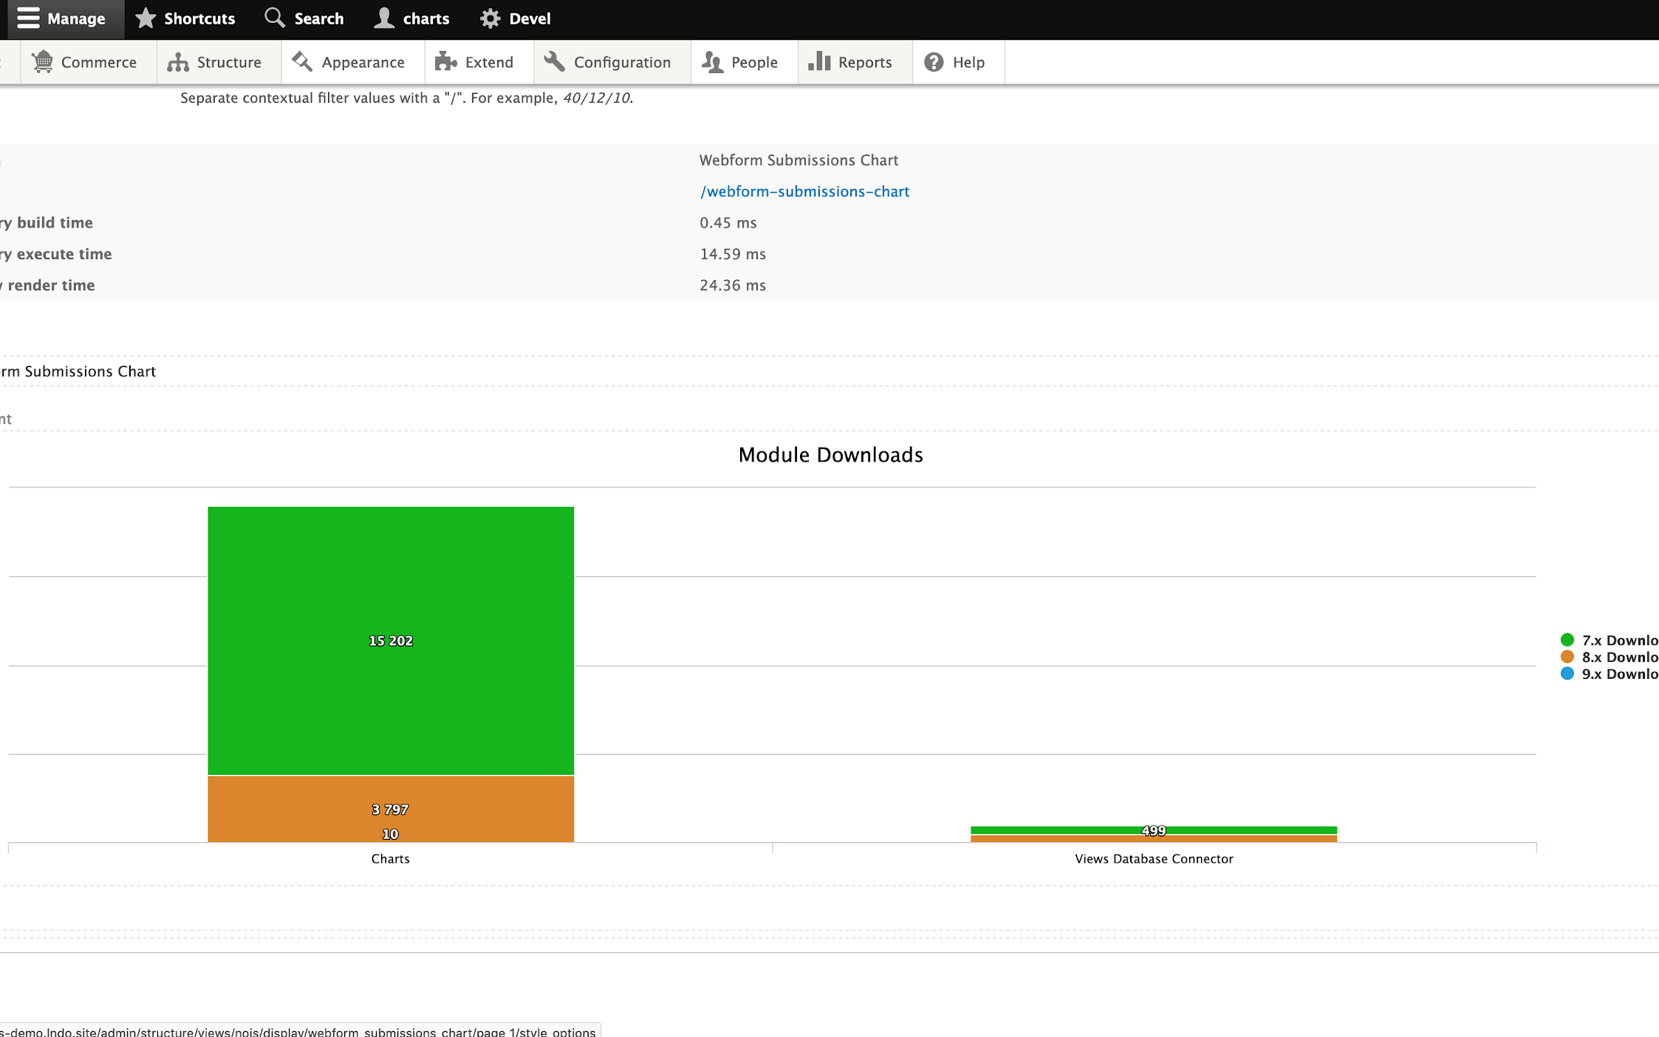
Result 2:
Stack the chart for a different way to present the data

Slide 37
Option 2: Webform, Webform Content Creator, and Views
Pros:
Nodes are a little easier to query in Views
Cons:
Additional configuration
Two copies of the same data
Webform Content Creator is not yet mature
Notes:
A second option for creating charts based on Webform results uses Webform Content Creator to turn those results into nodes, which can then be queried in Views and displayed as Charts. This tends to be a little easier to query in Views than the Webform Submissions table, and it gives you a little additional flexibility when it comes to your data structure; for example, you can turn a single Webform submission into multiple nodes.
Drawbacks to this approach are that you have to set up the connection between the Webform submission and the node, you have two copies of the same data, the opportunity for something to go wrong in the process of node creation, and a contributed module that is fairly new and not mature (not covered by the security policy, and only ~200 users).

Slide 38
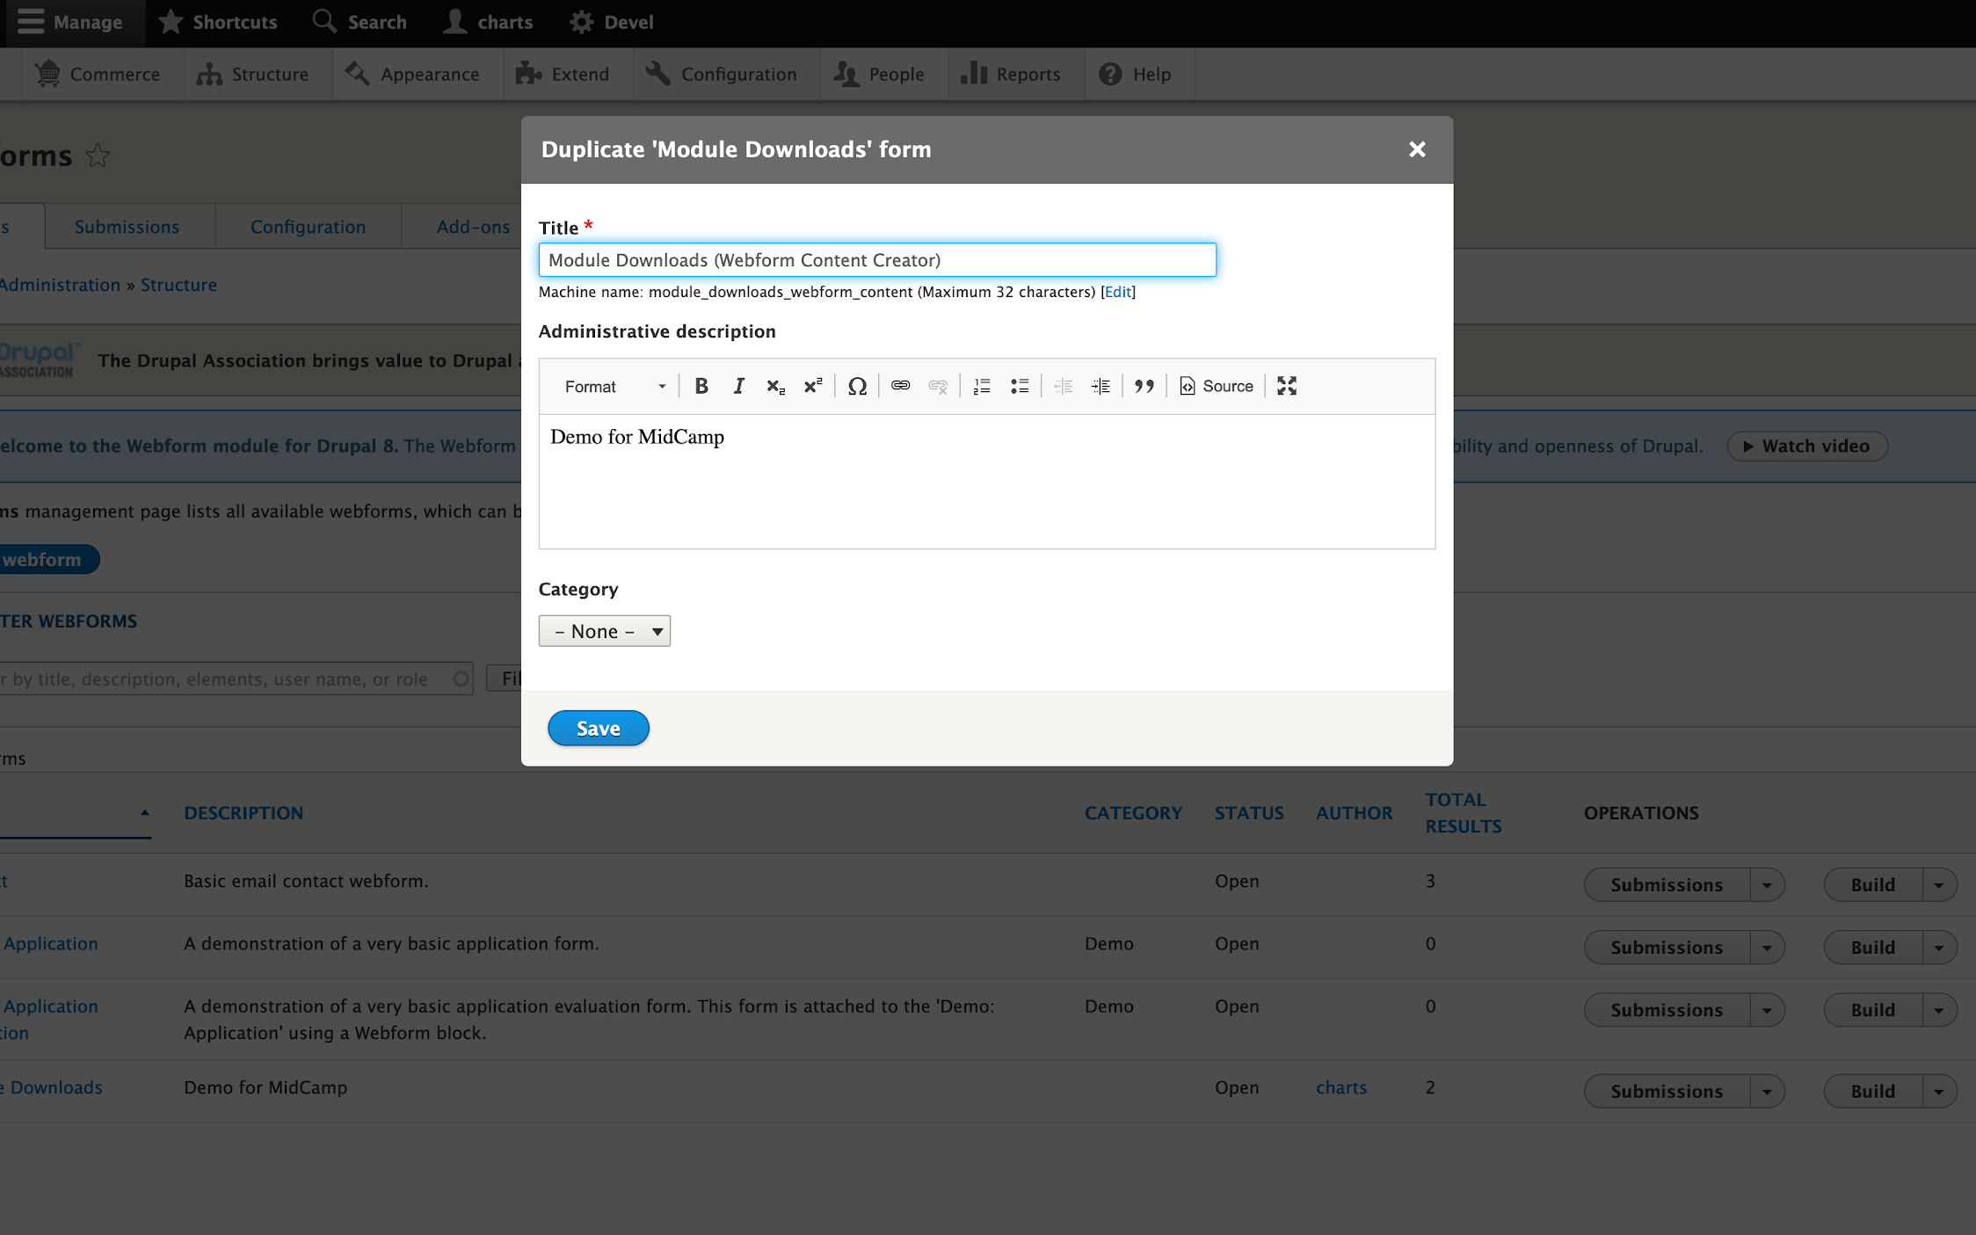
Step 1:
Create a new Webform

Slide 39
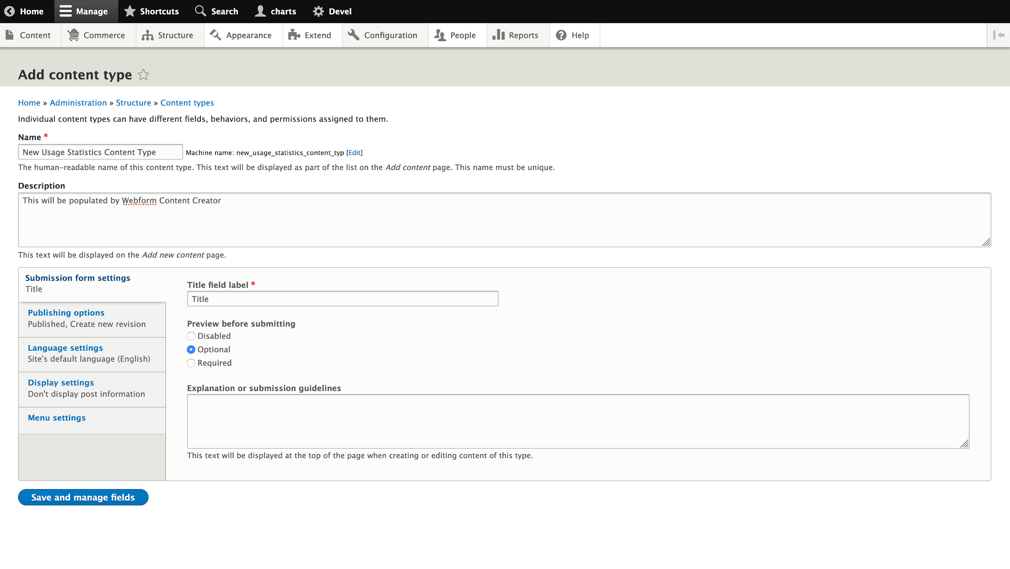
Step 2:
Create a content type to be created at form submission

Slide 40
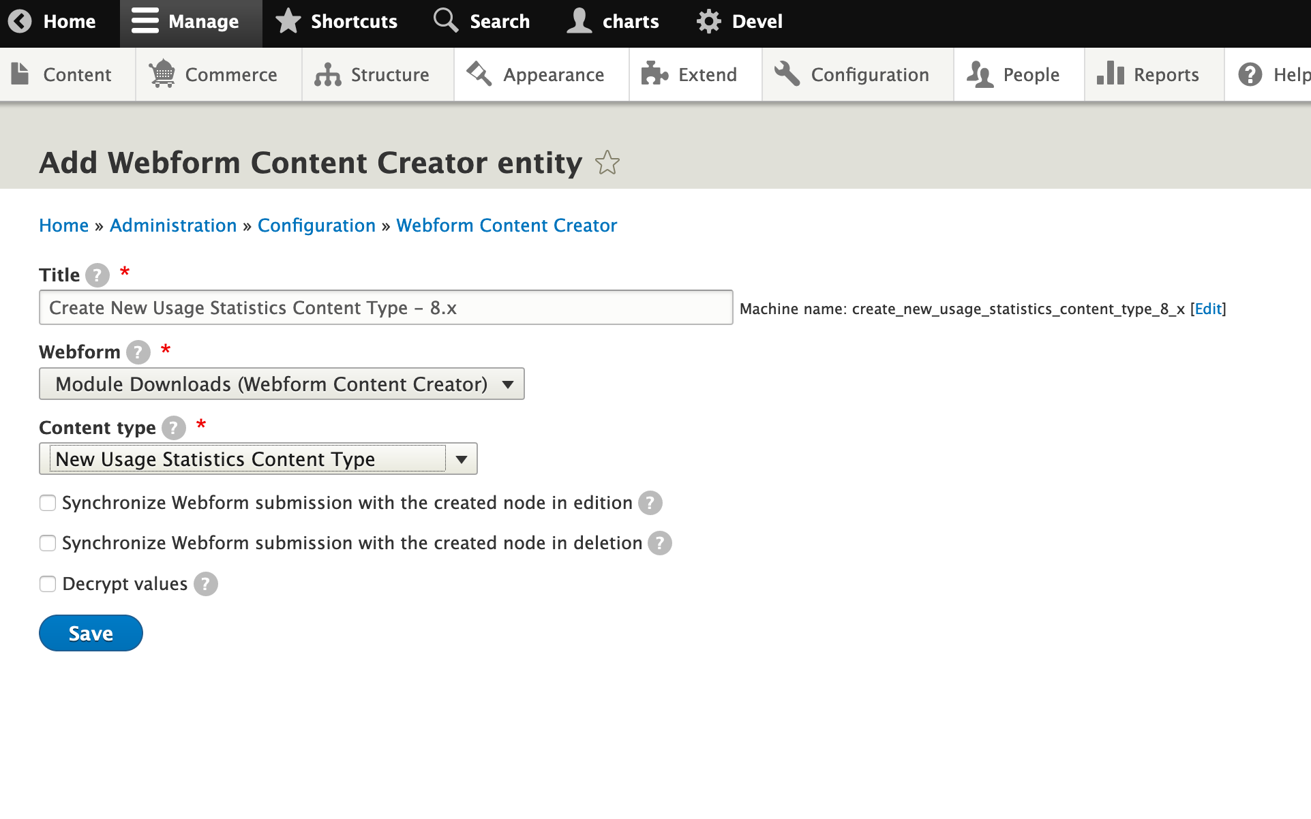
Step 3:
Create Webform Content Creator entity

Slide 41
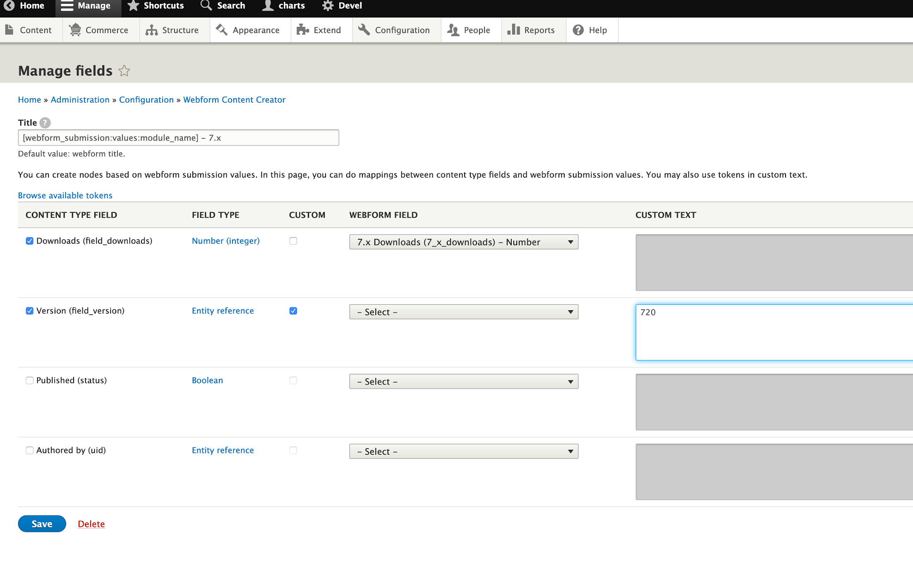
Step 4:
Configure the Webform Content Creator entity

Slide 42
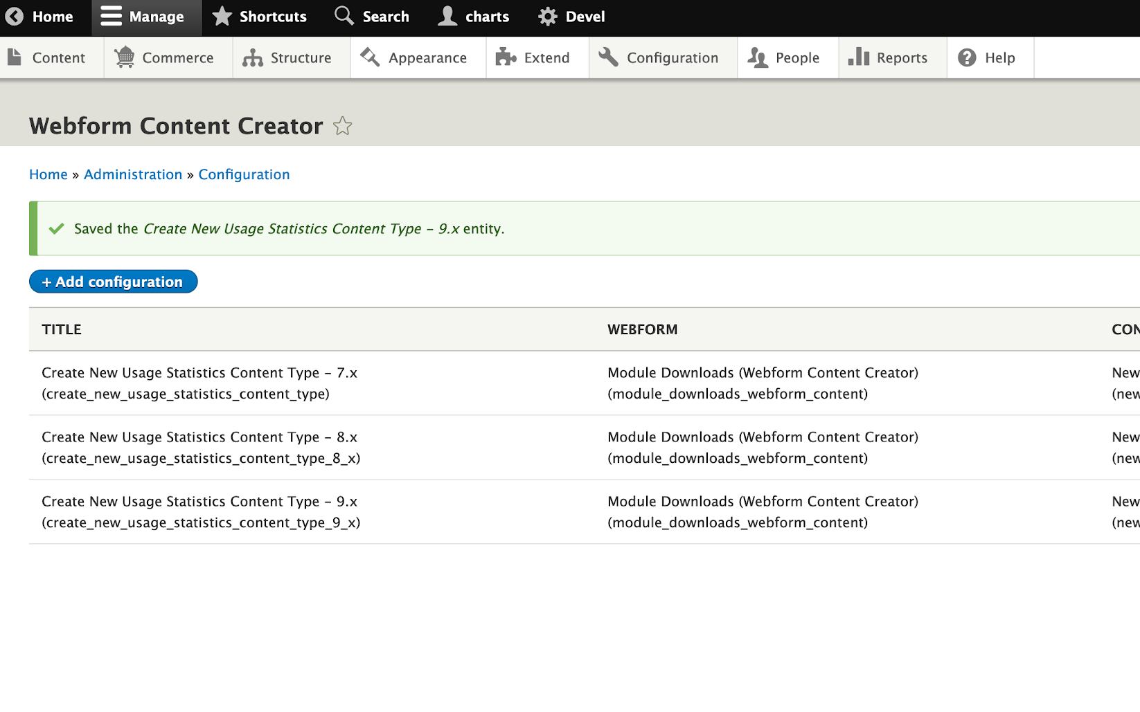
Step 5:
Create as many Webform Content Creator entities as necessary

Slide 43
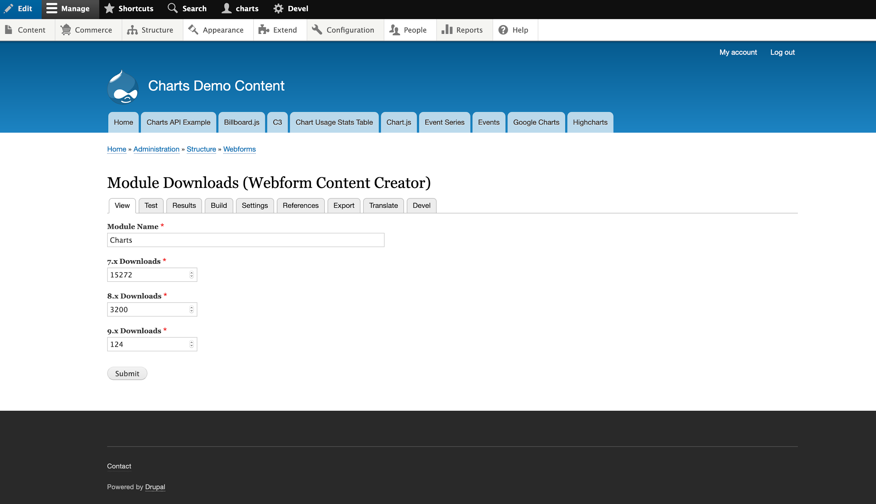
Step 6:
Submit the Webform

Slide 44
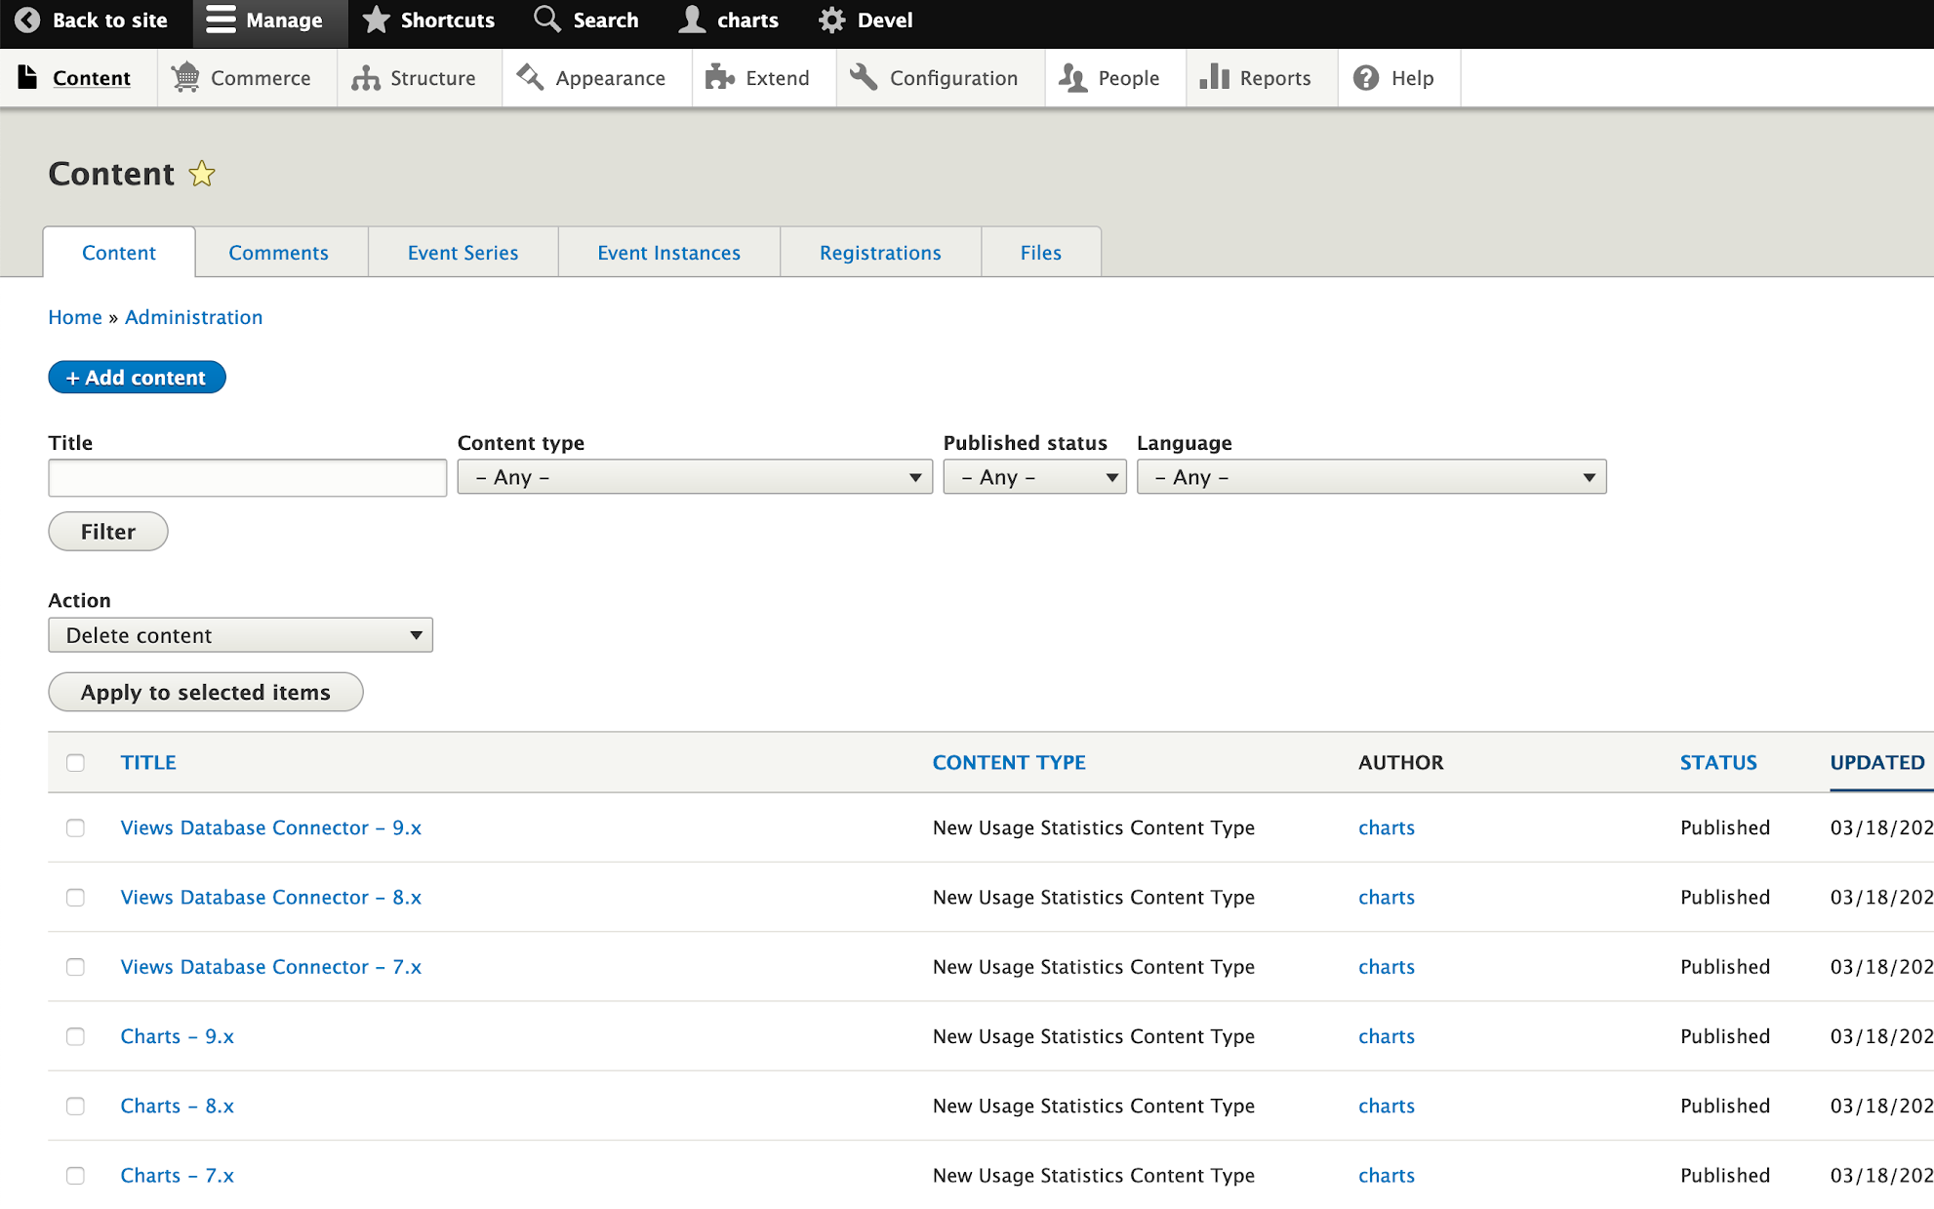
Step 7:
Verify content has been created

Slide 45
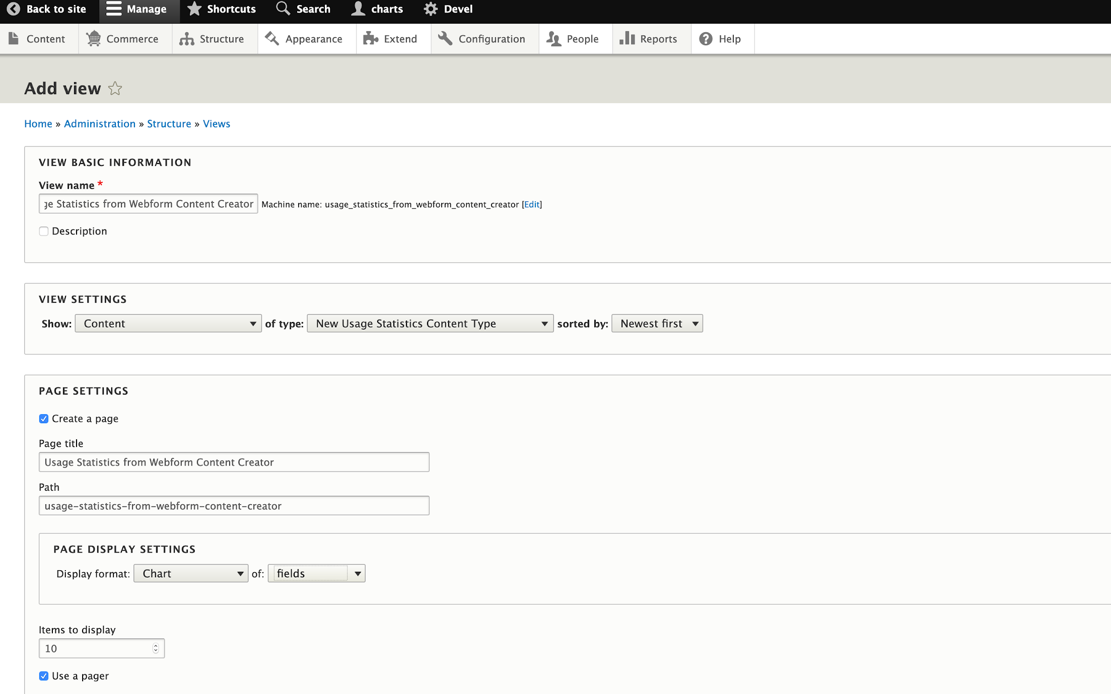
Step 8:
Add a View of your created content type

Slide 46
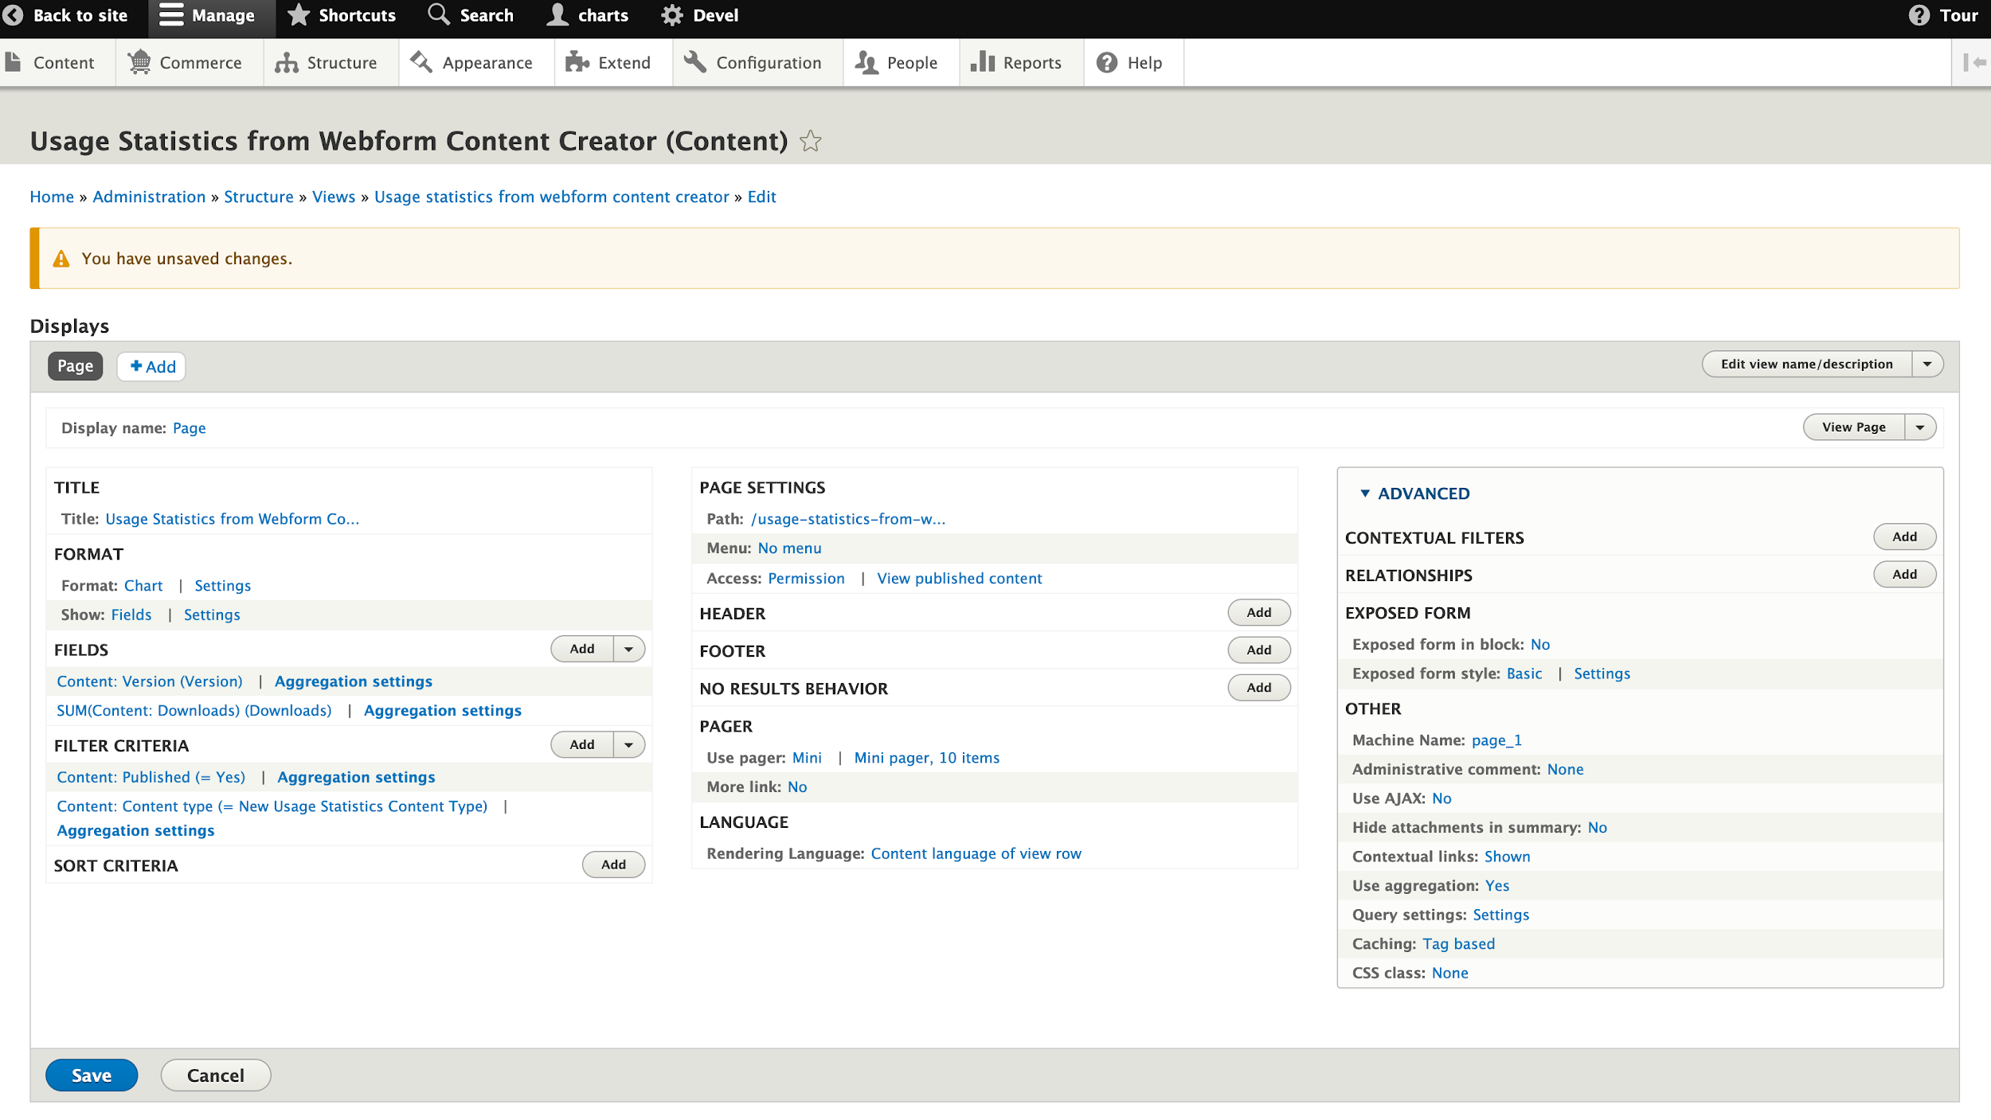
Step 9:
Configure View

Slide 47
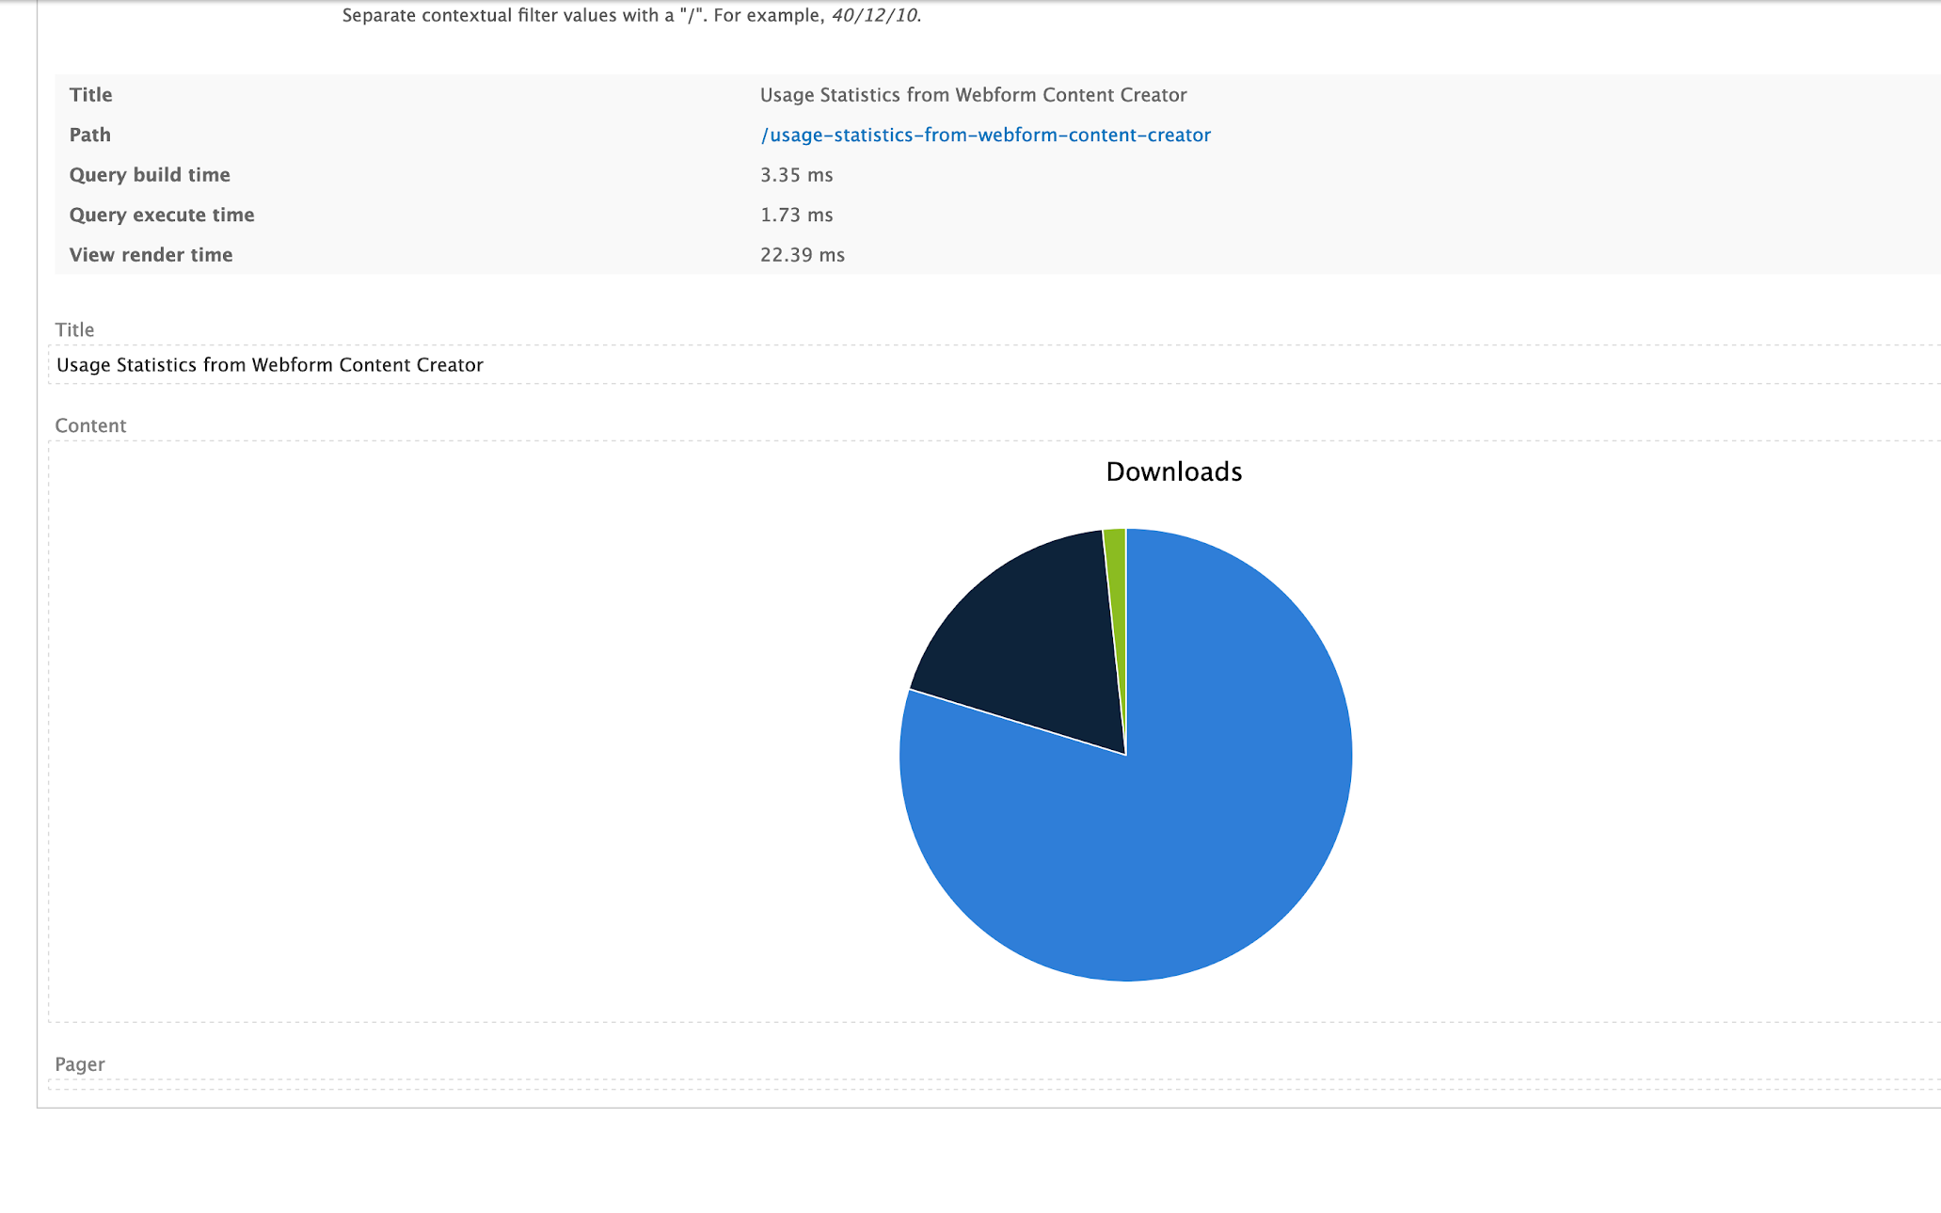
Result 1:
Preview your View

Slide 48
Scenario 3: I want anonymous users to generate charts!

Slide 49
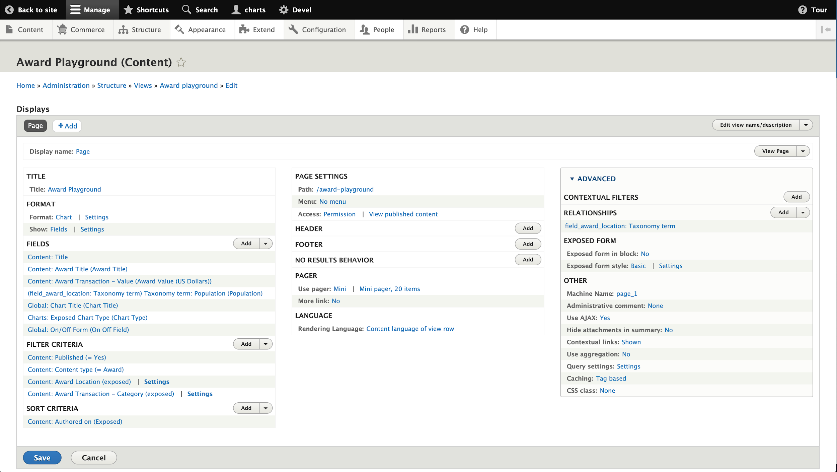
Step 1 - 3:
Enable Views Fields On/Off module, edit your View using a Chart display, and add and configure On/Off Form Field

Slide 50
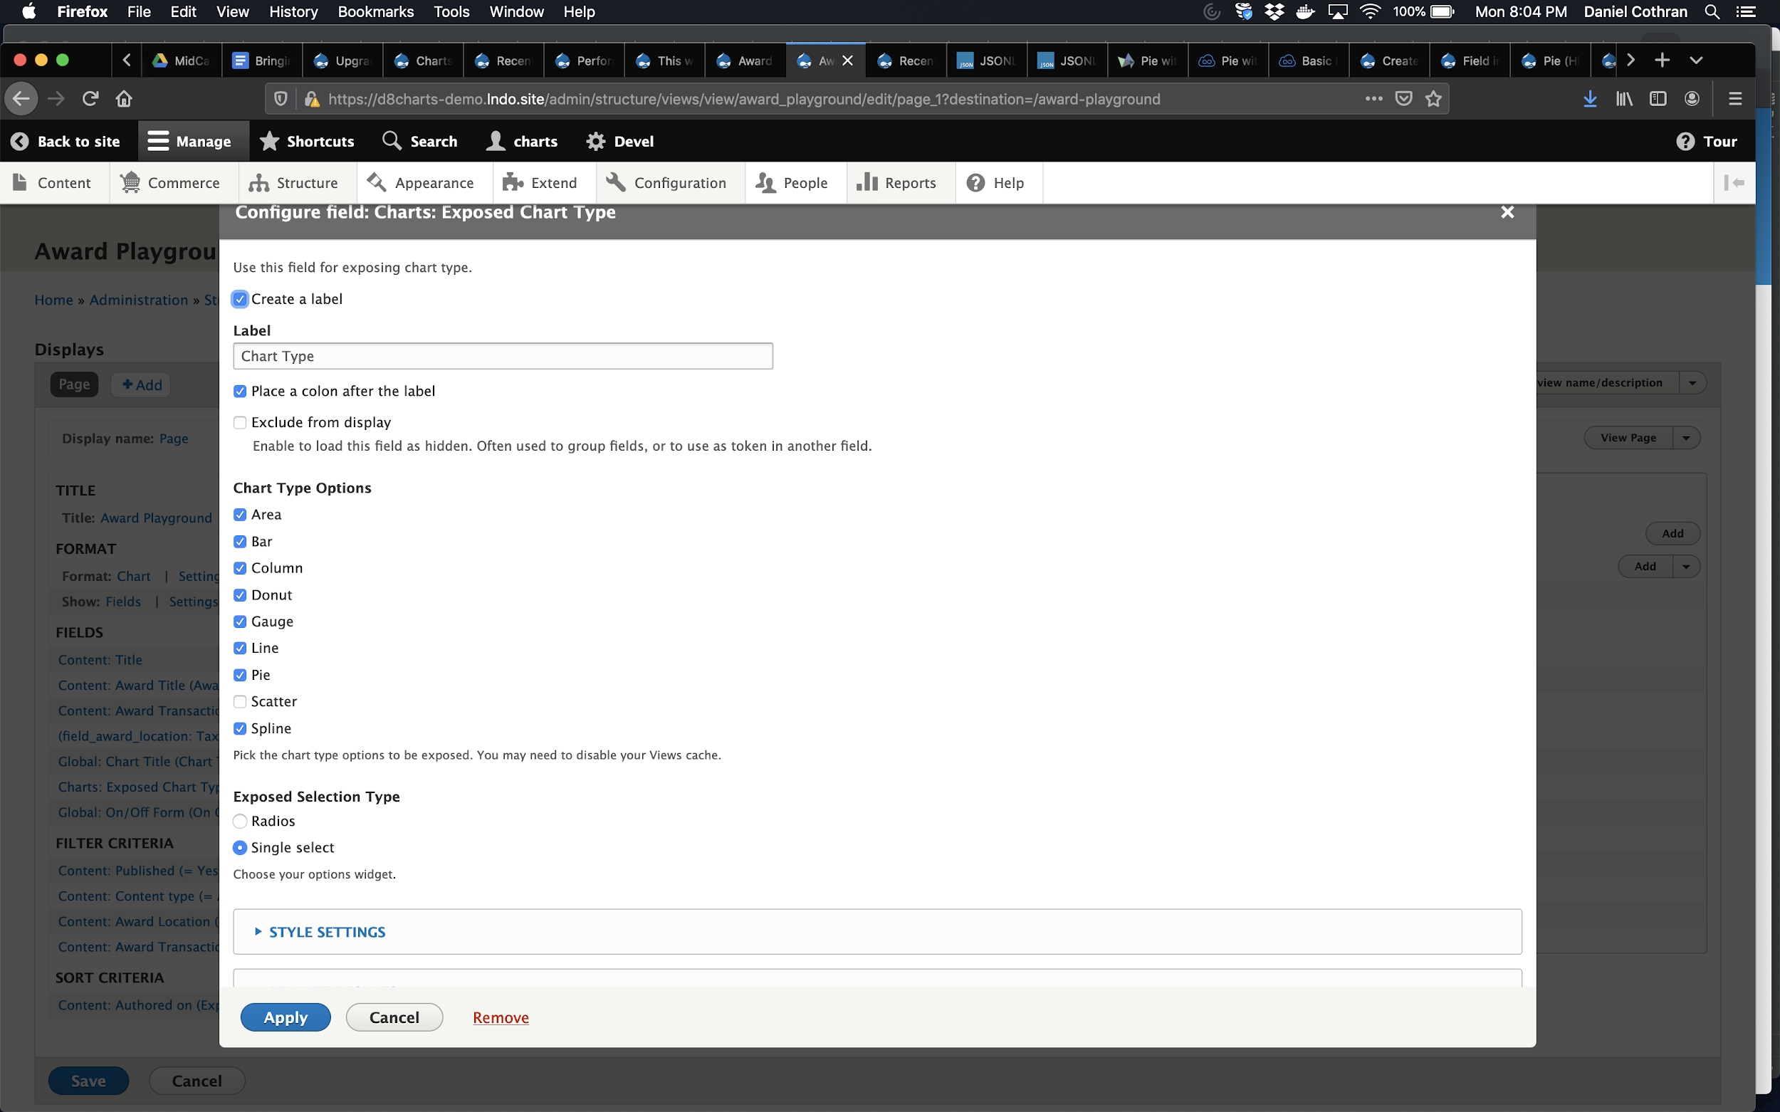
Step 4:
Add and configure Exposed Chart Type field

Slide 51
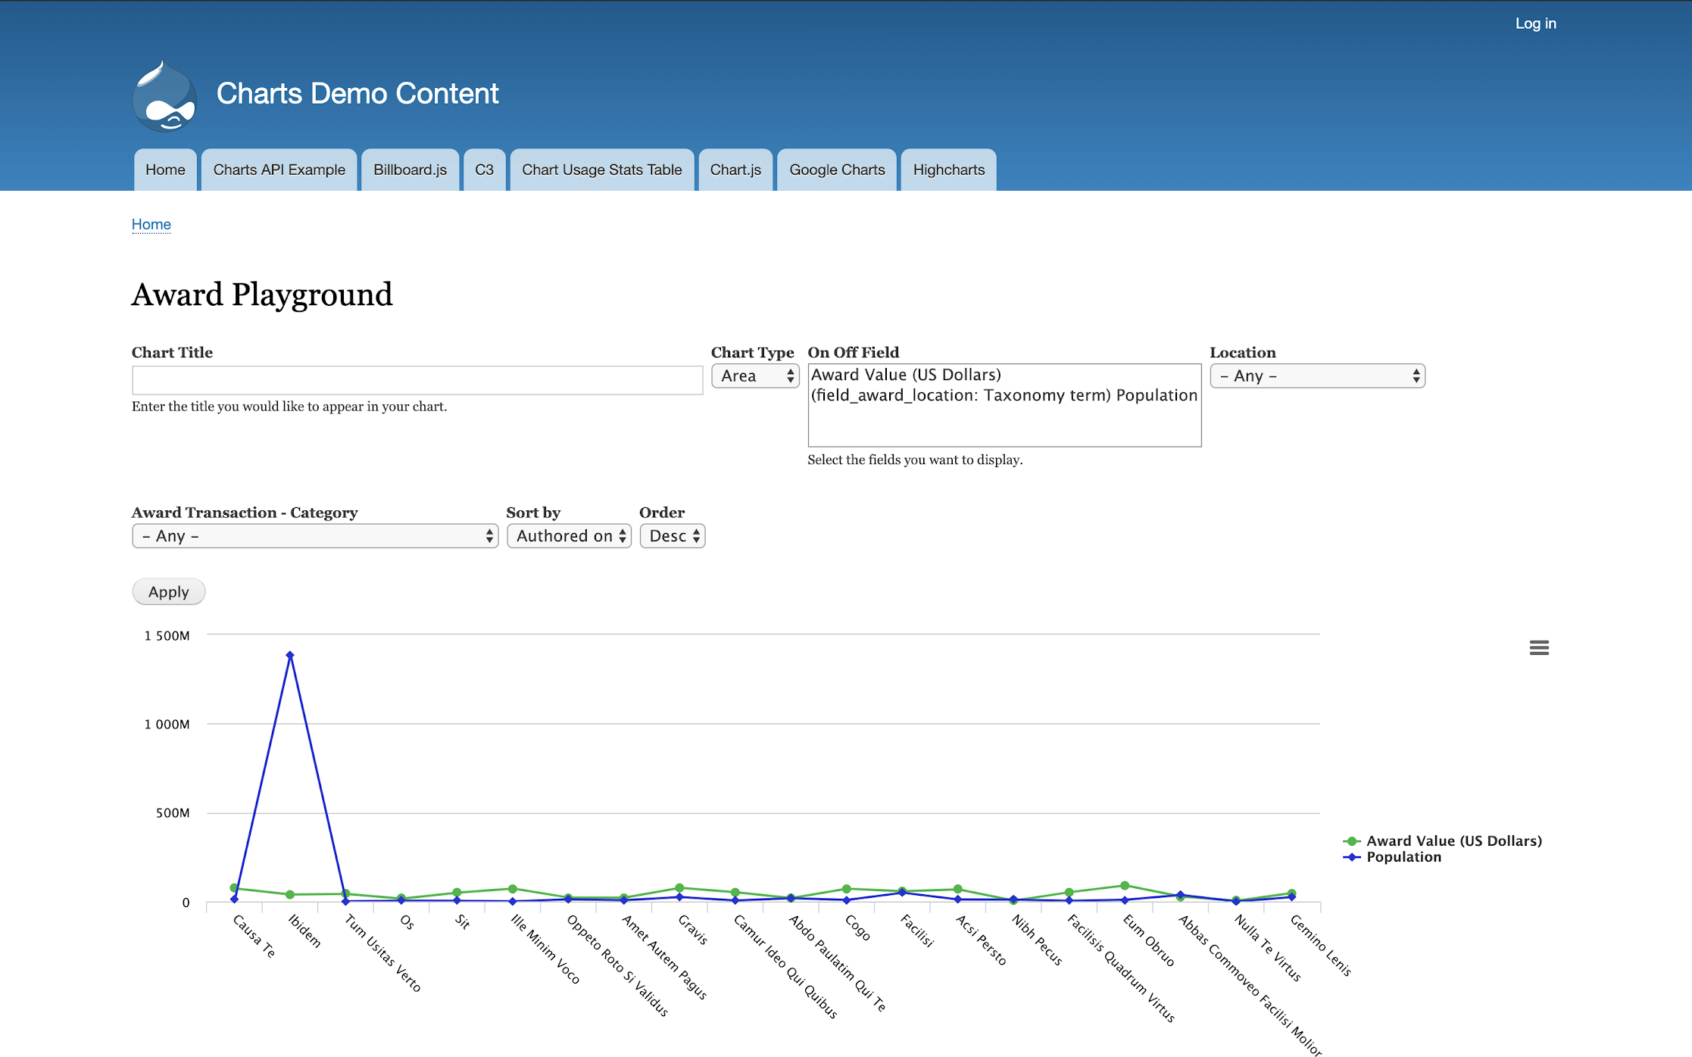
Step 5:
Save and see the unfiltered View (you can require input before showing the results)

Slide 52
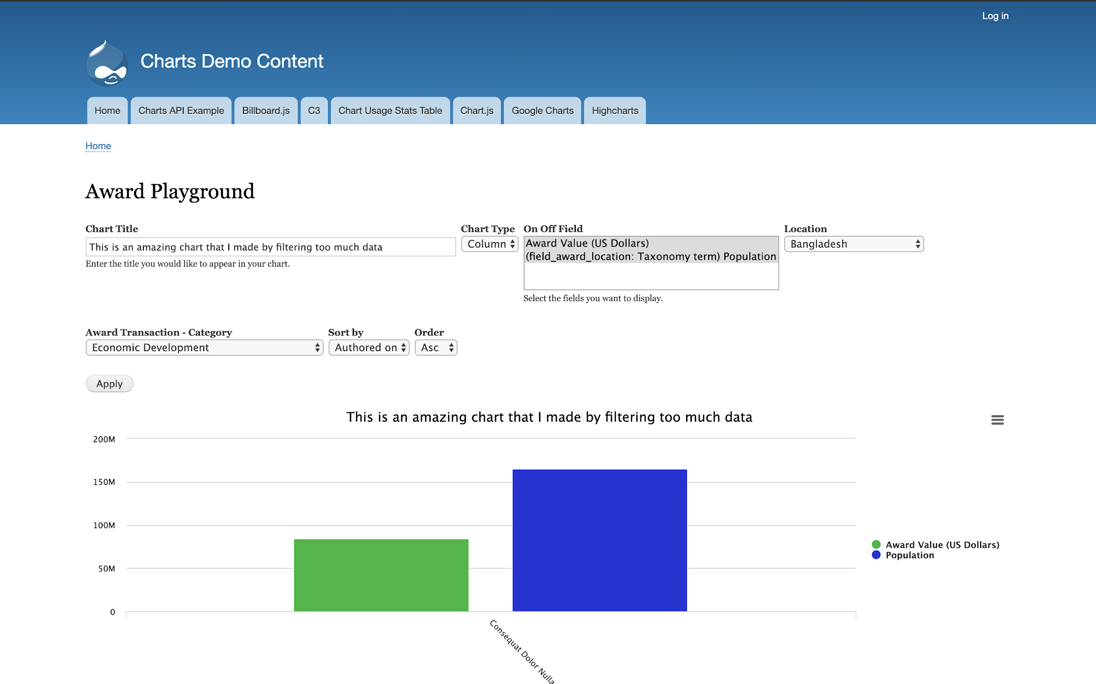
Step 6:
Viewing as an anonymous user who has applied a filter

Slide 53
Scenario 4: I want to report on Drupal Commerce!

Slide 54
If you are having issues charting Commerce price fields, the issue is probably that the Charts module is having difficulty getting the number separate from the currency. This module may help: https://github.com/andileco/commerce_views_connector

Slide 55

Other Charting Resources
DKAN Open Data Platform: https://getdkan.org/
CKEditor Plugin: http://wwalc.github.io/chart/
HighCharts Editor: https://www.highcharts.com/blog/news/240-announcing-the-free-embedable-highcharts-editor/
Notes:
So I mentioned before that I would tell you about some additional charting resources. First, I wanted to mention DKAN. As far as I know, they are still a Drupal distribution. They are focused on storing and visualizing data sets. The challenge with DKAN is that they are a distribution, so you have to start from DKAN, whereas with Charts, you can start with whatever site architecture you want, and add data visualization on top of that.
There’s a CKEditor plugin. It’s fairly limited in features, but extremely easy to use, and it’s great for adding charts into text area fields. However, it can’t help you if you want a View.
The Highcharts library also has an embeddable “editor” tool. I haven’t used this, but Highcharts has many great features, so I imagine this works well.

Slide 56
THANK YOU! QUESTIONS? COMMENTS?
Notes:
That’s the end of my formal presentation. You remember I asked you to think about scenarios in which you might want charts? Now’s the perfect time to share those scenarios. I’m happy to field any other Charts-related questions.

Slide 57
PLEASE PROVIDE YOUR FEEDBACK!
mid.camp/6340
The top rated sessions will be captioned, courtesy of Clarity Partners

Slide 58
CONTRIBUTION DAY
Saturday 10am to 4pm
You don't have to know code to give back!
New Contributor training 10am to Noon with AmyJune Hineline of Kanopi Studios

